Slide 1




Integrative Research Group
Brian Mc Conkey, Jean-François Soussana, Lee Nelson

Slide 2
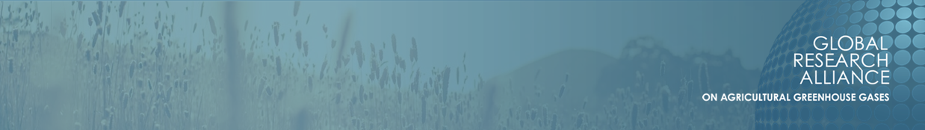
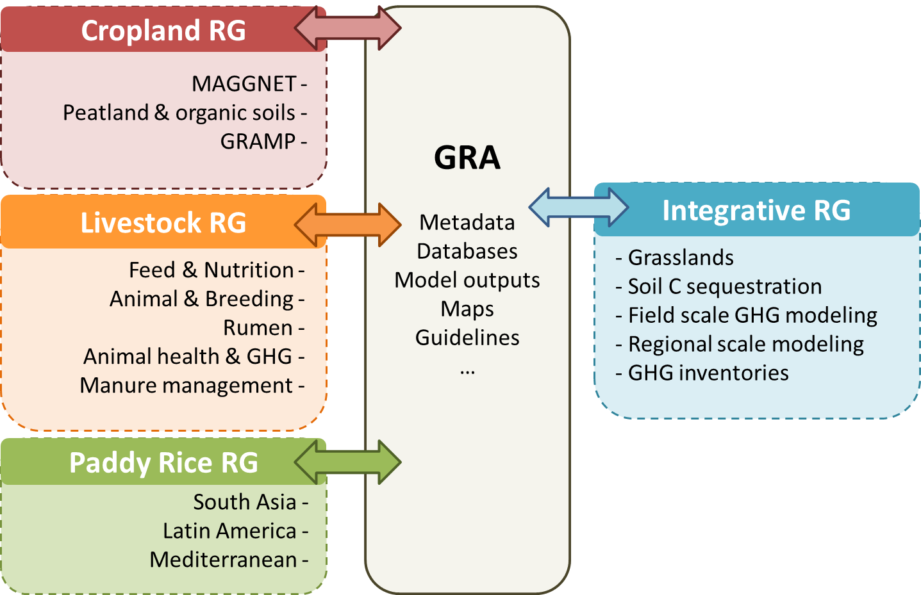
IRG: a new group approved by Council
end 2015

Slide 3
IRG vision and scope
Vision
Collaborative work to develop the knowledge and capabilities for estimation, monitoring, and projection of GHG emissions and soil carbon within and across agricultural systems
Scope: Address identified Research, Development, and Knowledge Transfer (R-D-KT) opportunities
Integration of scales (local, subnational, national, and supranational scales)
Applying, reporting, monitoring, and/or verifying greenhouse gas emission estimates across farming systems
Communicate and coordinate
Foster the building of capability of member countries.

Slide 4
IRG meetings
Joint session with the Livestock Research Group (Melbourne, February 2016)
Briefing during Paddy Rice Research Group America’s meeting (Arkansas, July 2016)
Briefing session during Council Meeting (Mexico City, October 2016)
Joint Session with the Cropland Research Group (Phoenix, November 2016)
Network meeting Field Scale Integration (Rome, March 2016)
IRG group meeting, side by side with FAO/IPCC meeting on soil carbon (January 19-20 ,2017, Rome)

Slide 5
Integrative Research Group achievements
10 member countries have joined so far
The group has been set-up with five research networks
Terms of reference have been established for the group and for the networks
Each network has expressed 3-5 priority actions, accounting for feedbacks during meetings
Monthly teleconferences with network leaders and webinars

Slide 6
Integration across scales
Grasslands
Soil carbon
Field
Farm, region
Inventories
Developing strategies for pastures
Quantifying soil carbon potential
Understanding M&A options at field scale
Improving tests of options at farm and region scale
Improving national inventories

Slide 7
Networks
Grasslands: F. Lattanzi (Uruguay), K. Richards (Ireland),
Soil carbon sequestration: C. Chenu (France), D. Angers (Canada),
Field scale : JF Soussana (France), P. Smith (UK),
Farm and regional scale : R. Eckard (Australia), P. Havlik (IIASA),
GHG inventories: J. Verhagen (Netherlands), B. Mc Conkey (Canada).

Slide 8
Priorities in each network (1/3)
Grasslands
Guidelines for SOC measurement/monitoring in grasslands,
Data base on grazing practices vs. soil C and GHG emissions
Mixed systems (temporary grasslands, integrated systems)
Highlight: National project in Uruguay supported by GEF
Soil carbon sequestration
Co-benefits of soil carbon for yields and adaptation,
Monitoring, reporting and verification of soil carbon
Soil organic carbon dynamics modeling
Highlight: Permanence of soil carbon vs. duration of practices

Slide 9
Priorities in each network (2/3)
Field scale
Mitigation and adaptation options assessed from multi-model ensemble
Climate sensitivity of GHG emissions and soil carbon
Statistical emulators for N₂O emissions and soil C
Highlight: accurate multi-model simulations of N₂O emissions
Farm and regional scale integration
Demonstration farm network
Farm calculators and soil carbon
Pilot region assessment studies
Regional maps of mitigation and adaptation potentials
Highlight: Corn yield loss and land degradation under climate change

Slide 10
Priorities in each network (3/3)
GHG inventories
Guidance on how to improve inventories, including data on activities,
Moving to Tier 2, sharing examples from countries,
Country specific emission factors
Highlight: Applications of earth observation (remote sensing) for national inventories

Slide 11





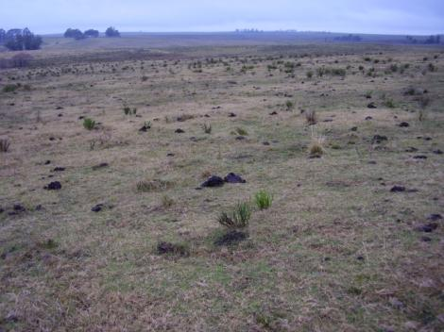
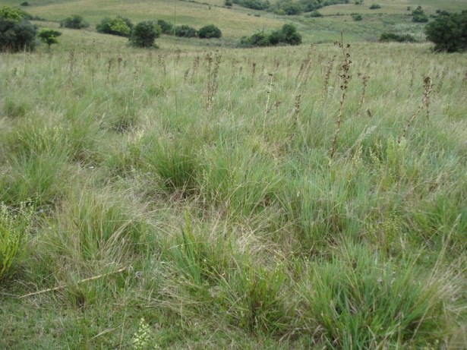
Highlight (1/5)
A national project by URUGUAY supported by GEF/ FAO (World Bank) to increase beef production and store carbon in soils
60 farms
Less SOC
Rebuilding SOC

Slide 12
Highlight (2/5)
Permanence of improved practices is key to achieving soil C sequestration potential
(INRA)

Slide 13
Highlight (3/5)
Without site specific information a multi-model ensemble predicts accurately N₂O emissions from crop and pasture across 4 continents
(Erhardt et al., 30 co-authors)

Slide 14
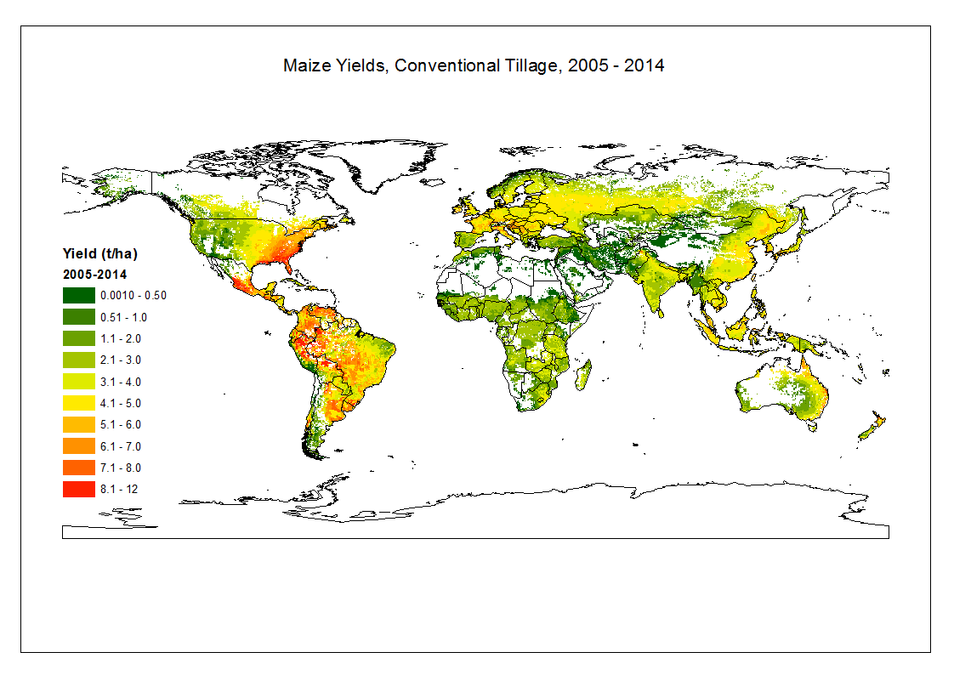
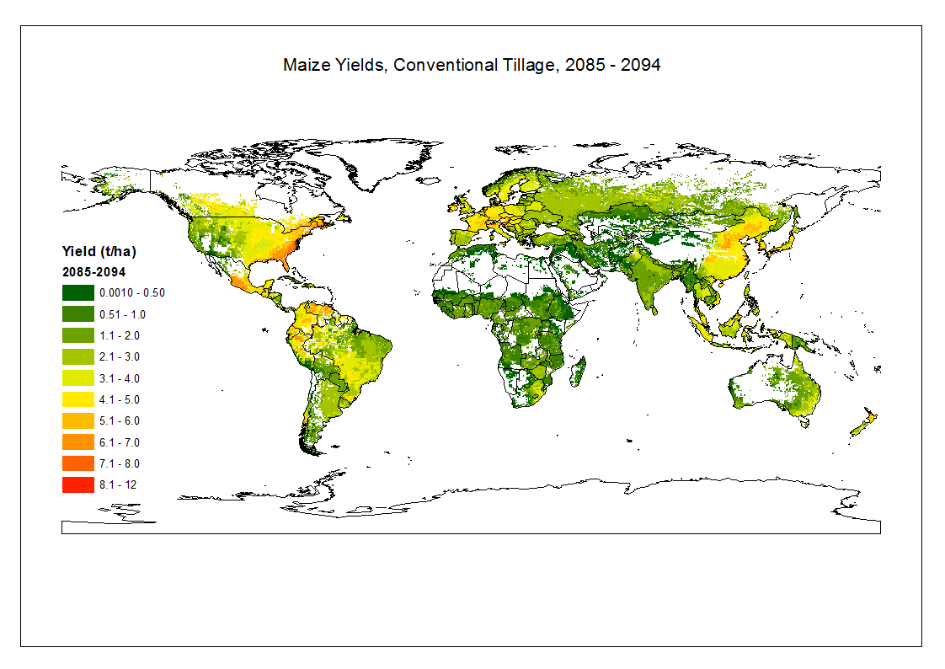
Highlight (4/5)
Land degradation lowers corn yields by end of century, due to losses in soil fertility in countries with low or negative nutrient surplus
(EPIC model, dynamic soil, RCP 2.6, IIASA)

Slide 15
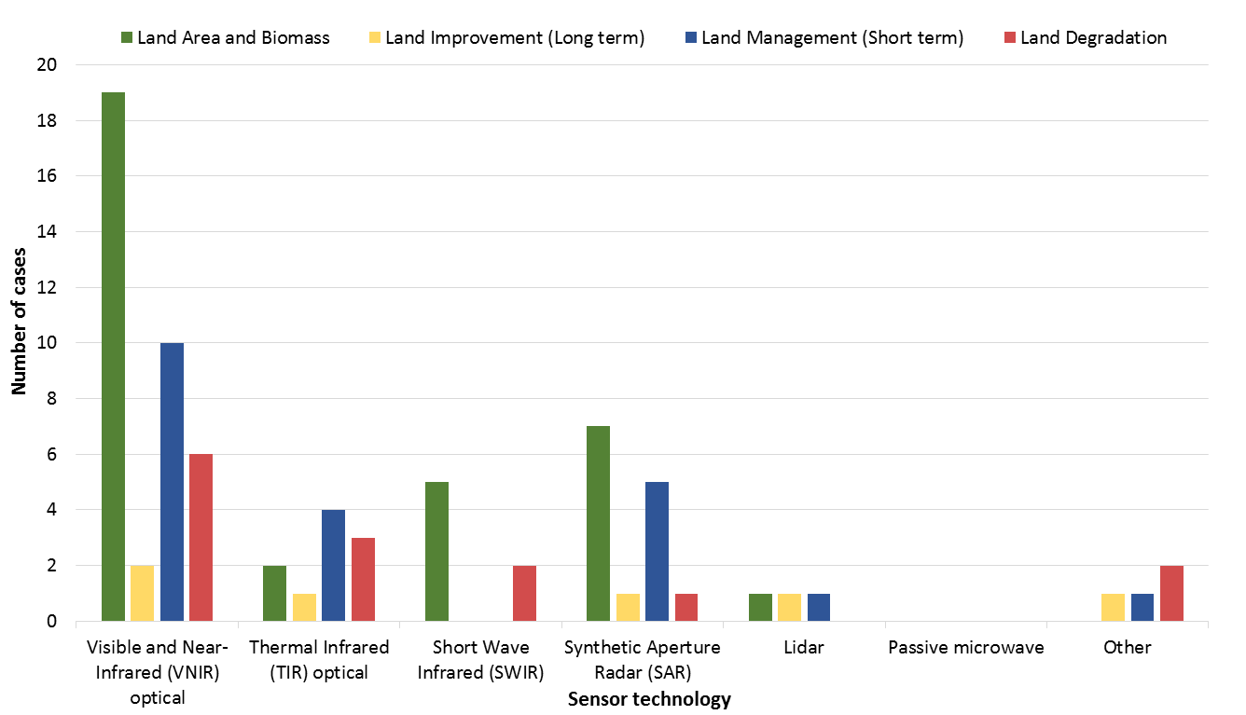
Highlight (5/5)
Capability building led by NZ and LRG, sharing and collaborating on methodologies, planning inventory meeting in 2017 (UK)
Sensor technologies being used by
GRA members for inventory purposes

Slide 16
Cropland Research Group and IRG
What are the opportunities that the CRG would like to collaborate with the IRG
  What topics and with what networks?
  Contribute to what flagships?
    IRG: Carbon sequestration and inventory
  Funding, human resources, and partners?
  What are some valuable outputs that could be produced within 12 months?
    Examples: Syntheses to inform decision making of policy makers,
    syntheses to inform decision making of the research community

