Slide 1
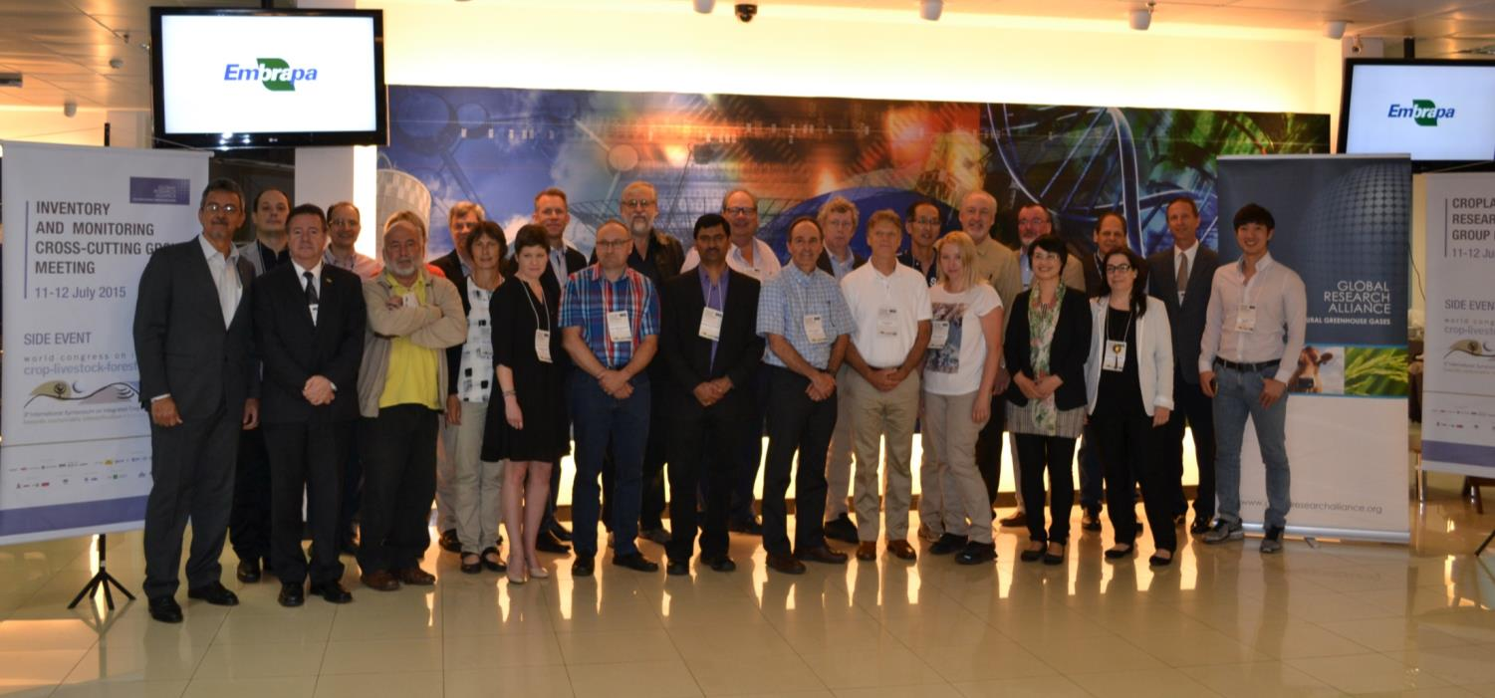
Review of 2015 CRG meeting
Joint Croplands and I&M Meeting – Brasilia BRAZIL – 11-12 July 2015

Slide 3
Alongside the…

Slide 4
Participants
25 participants from 12 member countries
Brazil | Norway
Canada | Poland
Chile | Spain
Denmark | UK
Japan | USA
Korea
Netherlands

Slide 5
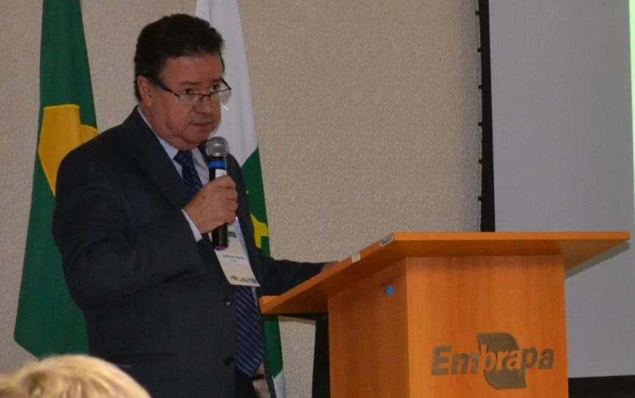
Issues covered
Welcome and outline of agenda by CRG Co-Chair

Slide 6
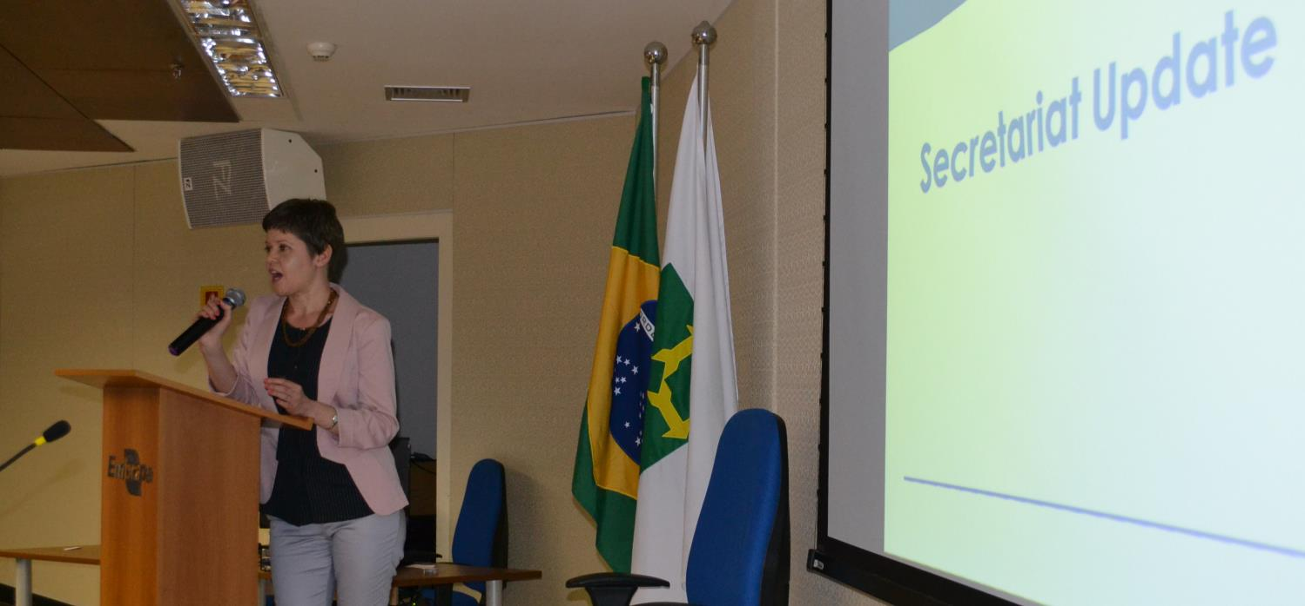
Issues covered
Update from the Alliance Secretariat including outcomes from the latest Council meeting

Slide 7
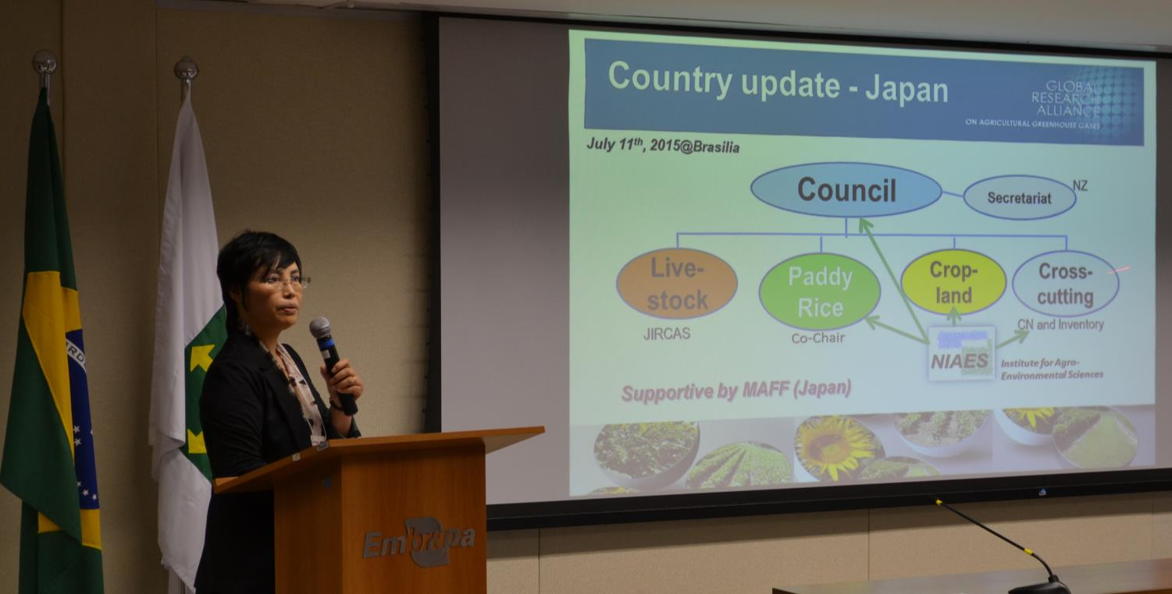
Issues covered
Research updates from member countries

Slide 8
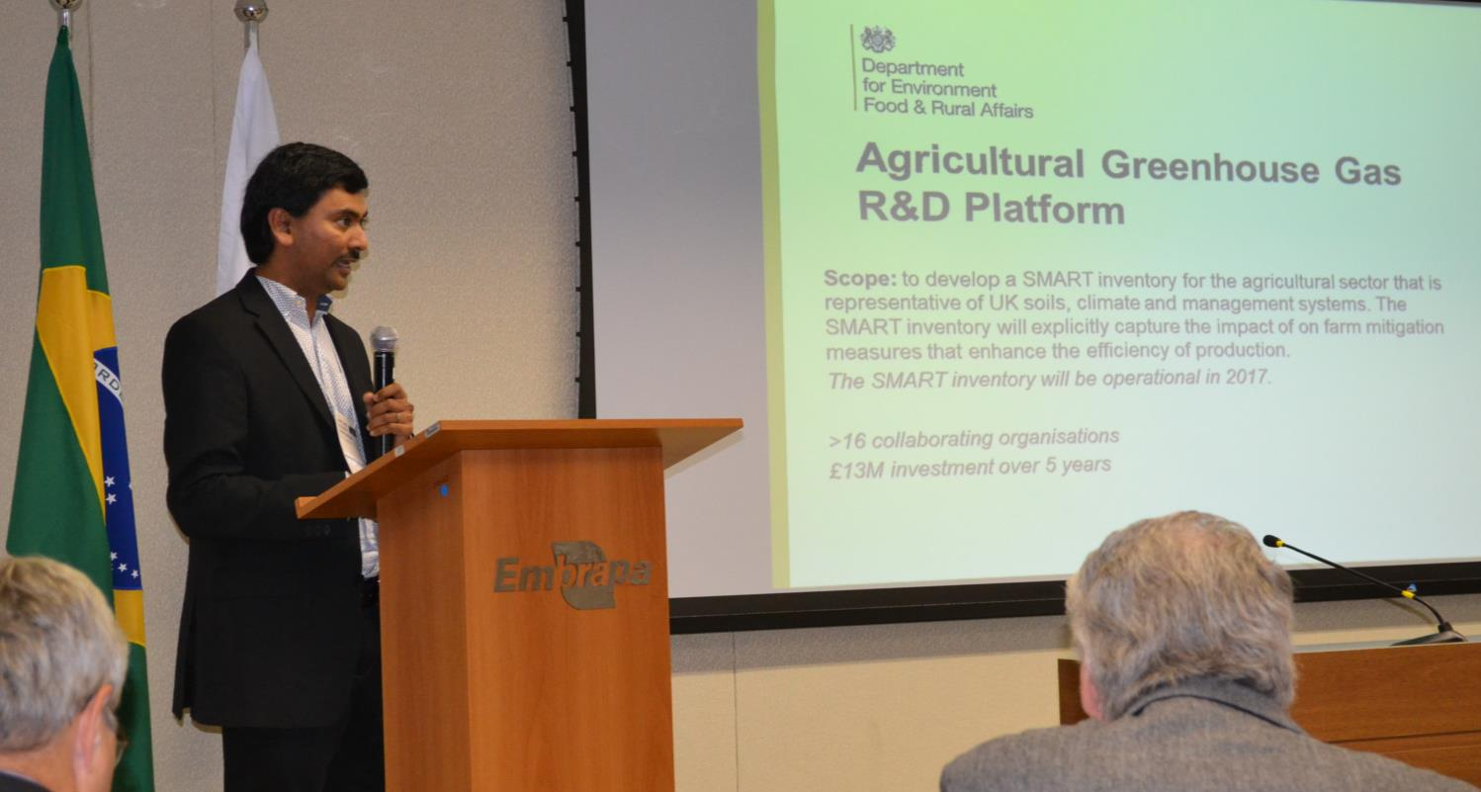
Issues covered
Updates from Component Leads

Slide 9
Issues covered
CABI partnership proposal
Sjoerd Croque (GRA) and CABI developed GRA-wide proposal of partnership
CABI approved GRA as affiliate member in April 2015
GRA Council will consider CABI as partner in September 2015 meeting in Des Moines and subsequently approved

Slide 10
Issues covered
Research network proposal
Existing and continuing activities
MAGGnet database – led by Mark Liebig, USA
Literature database – led by Chuck Rice, USA
GRAMP – led by Jagadeesh Yeluripati, UK
Facebook page – led by Ayaka Kishimoto-Mo, Japan
Proposed network themes
Agroforestry systems – led by Richard Farrell, Canada
Conservation agriculture – led by Craig Drury, Canada
Integrated crop-livestock systems – led by Alan Franzluebbers, USA
Integrated nutrient management – led by Rod Venterea, USA
Irrigation efficiency – led by Kevin Bronson, USA
Landscape management of agricultural systems – led by Xunhua Zheng, China
Peatland management – led by Hanna Silvennoinen, Norway
Note: Previous component on modeling C and N from soil was moved to the newly formed Integrative Research Group

Slide 11
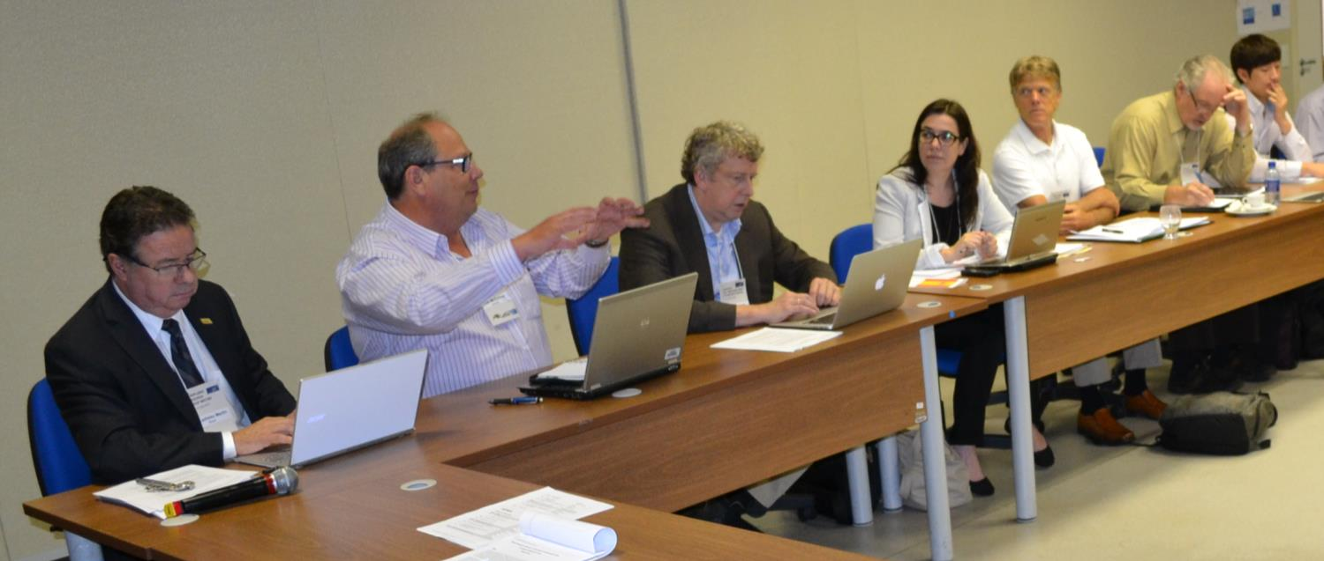
Issues covered
Inventory and monitoring cross-cutting group discussion

Slide 12
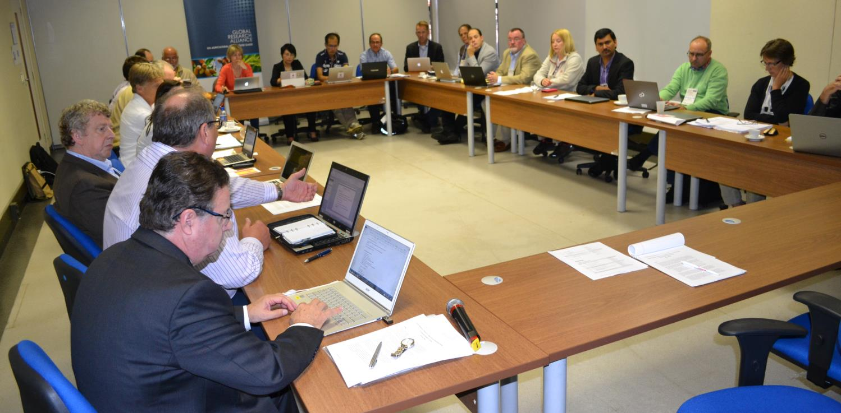
Issues covered
Regional working groups…?

Slide 13
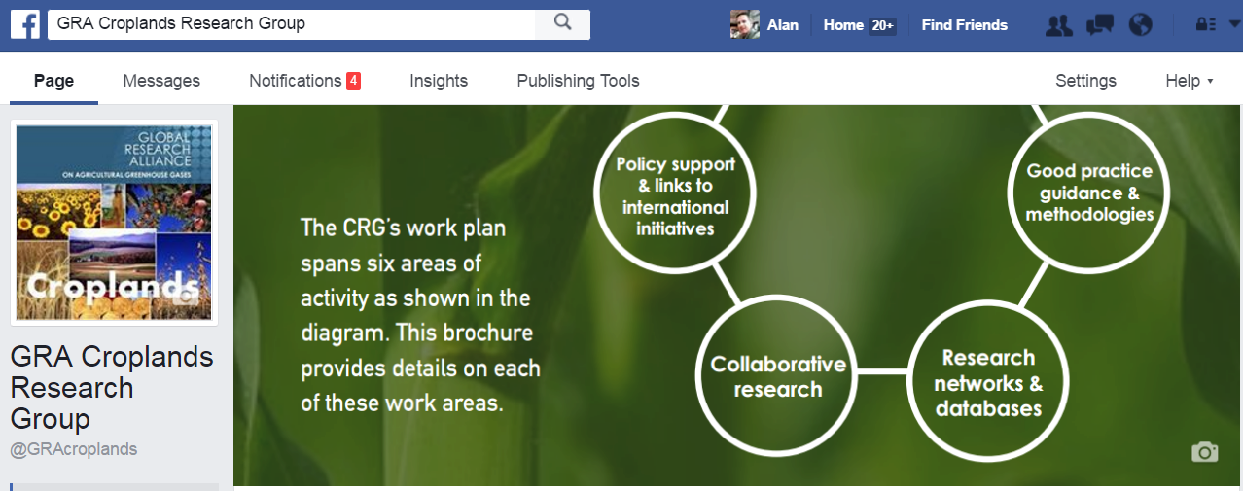
Issues covered
Communications
https://www.facebook.com/GRAcroplands

Slide 14
Issues covered
Future meetings and participation

Slide 15
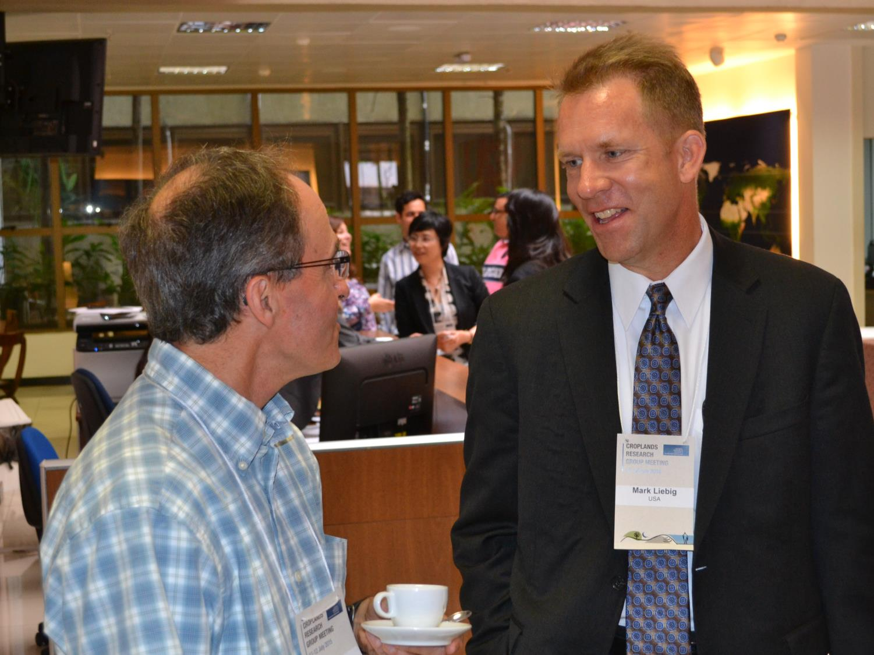
Opportunities for dialogue

Slide 16
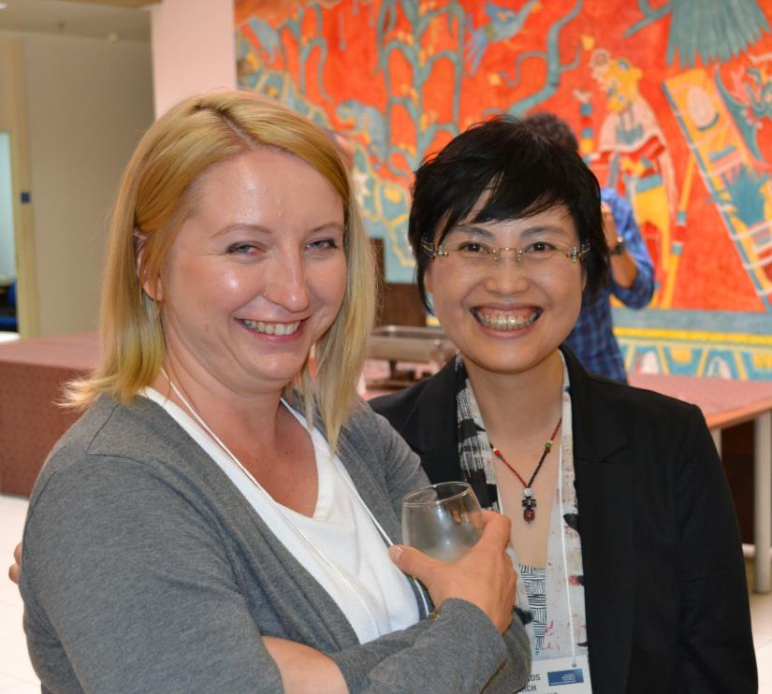
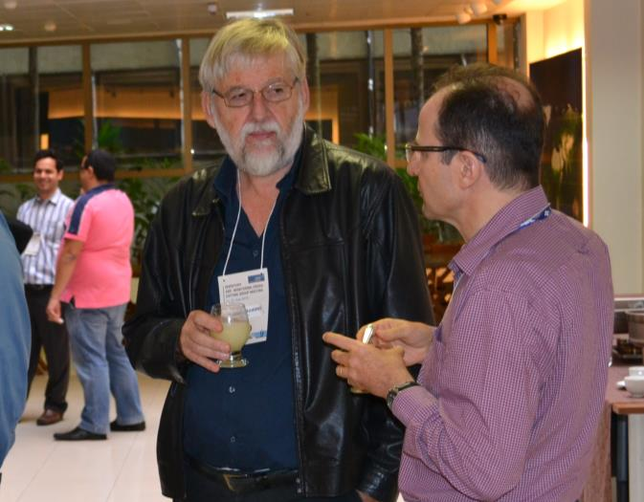
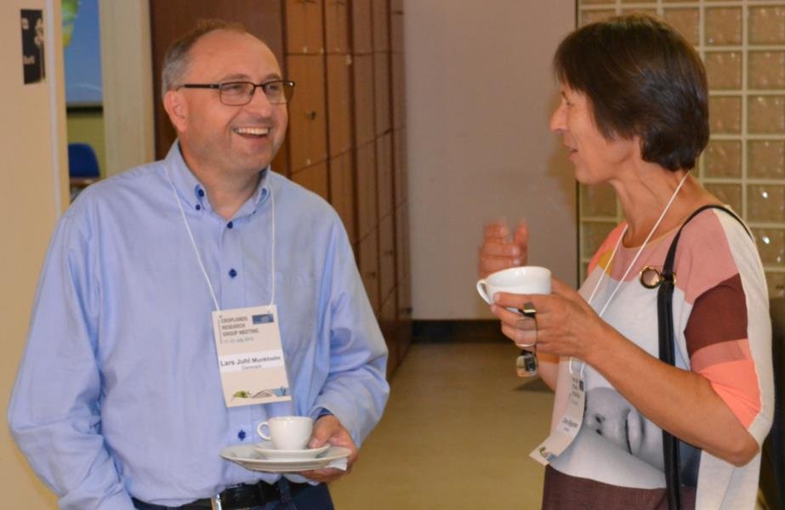
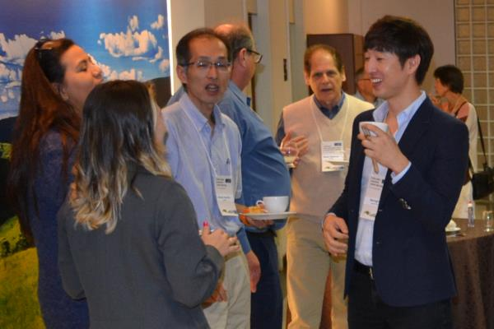

Slide 17
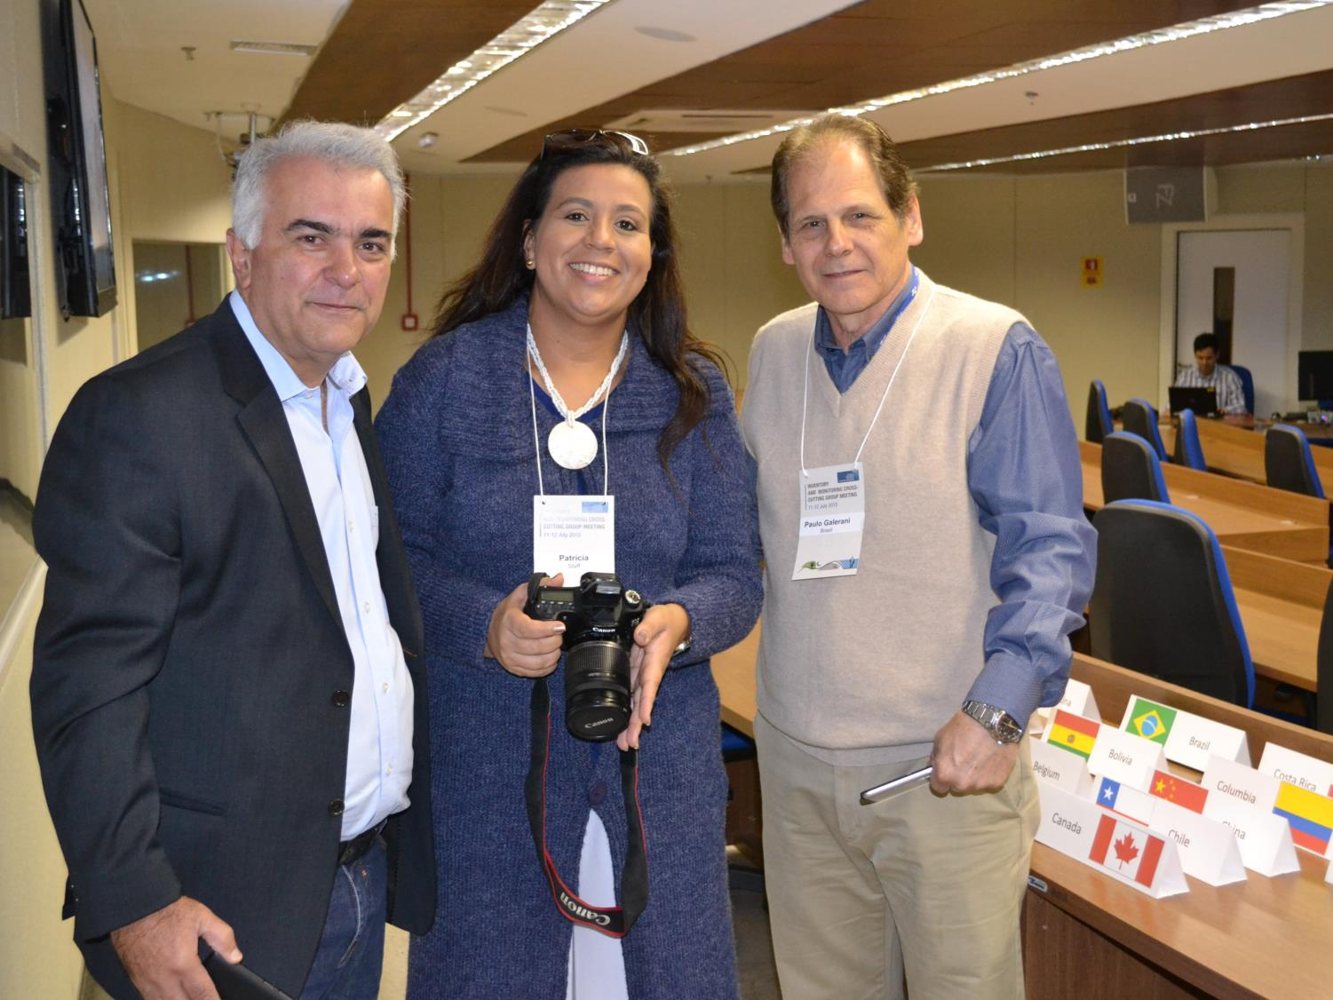
Thanks to the organizers!

Slide 18
Agreements

Slide 19
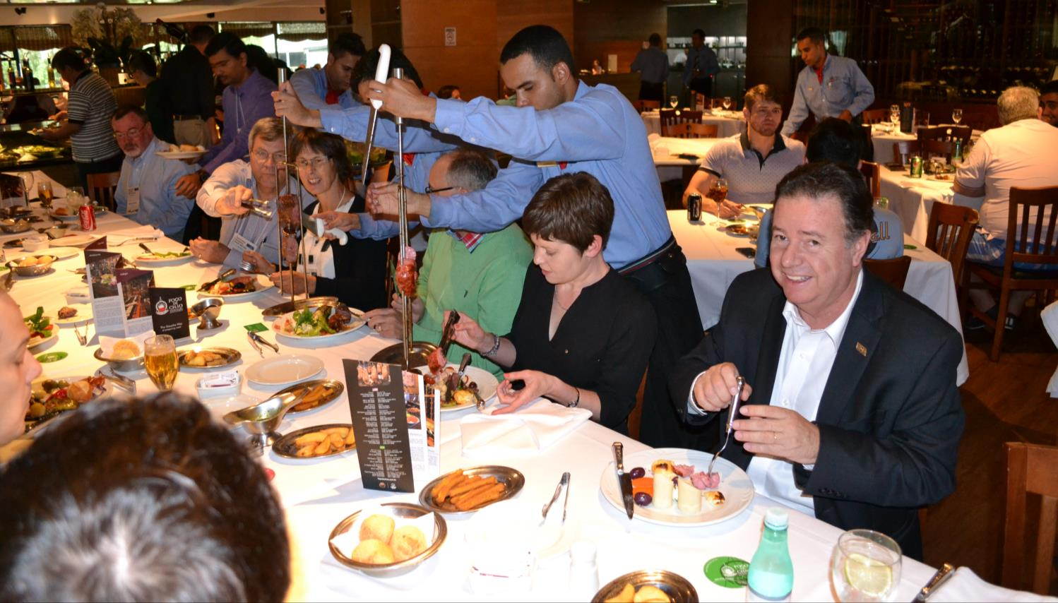
We also enjoyed ourselves!

Slide 20
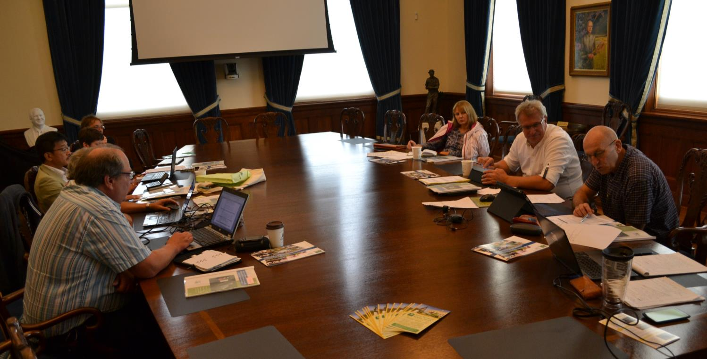
Developments
Formation of the Integrative Research Group

