Slide 1
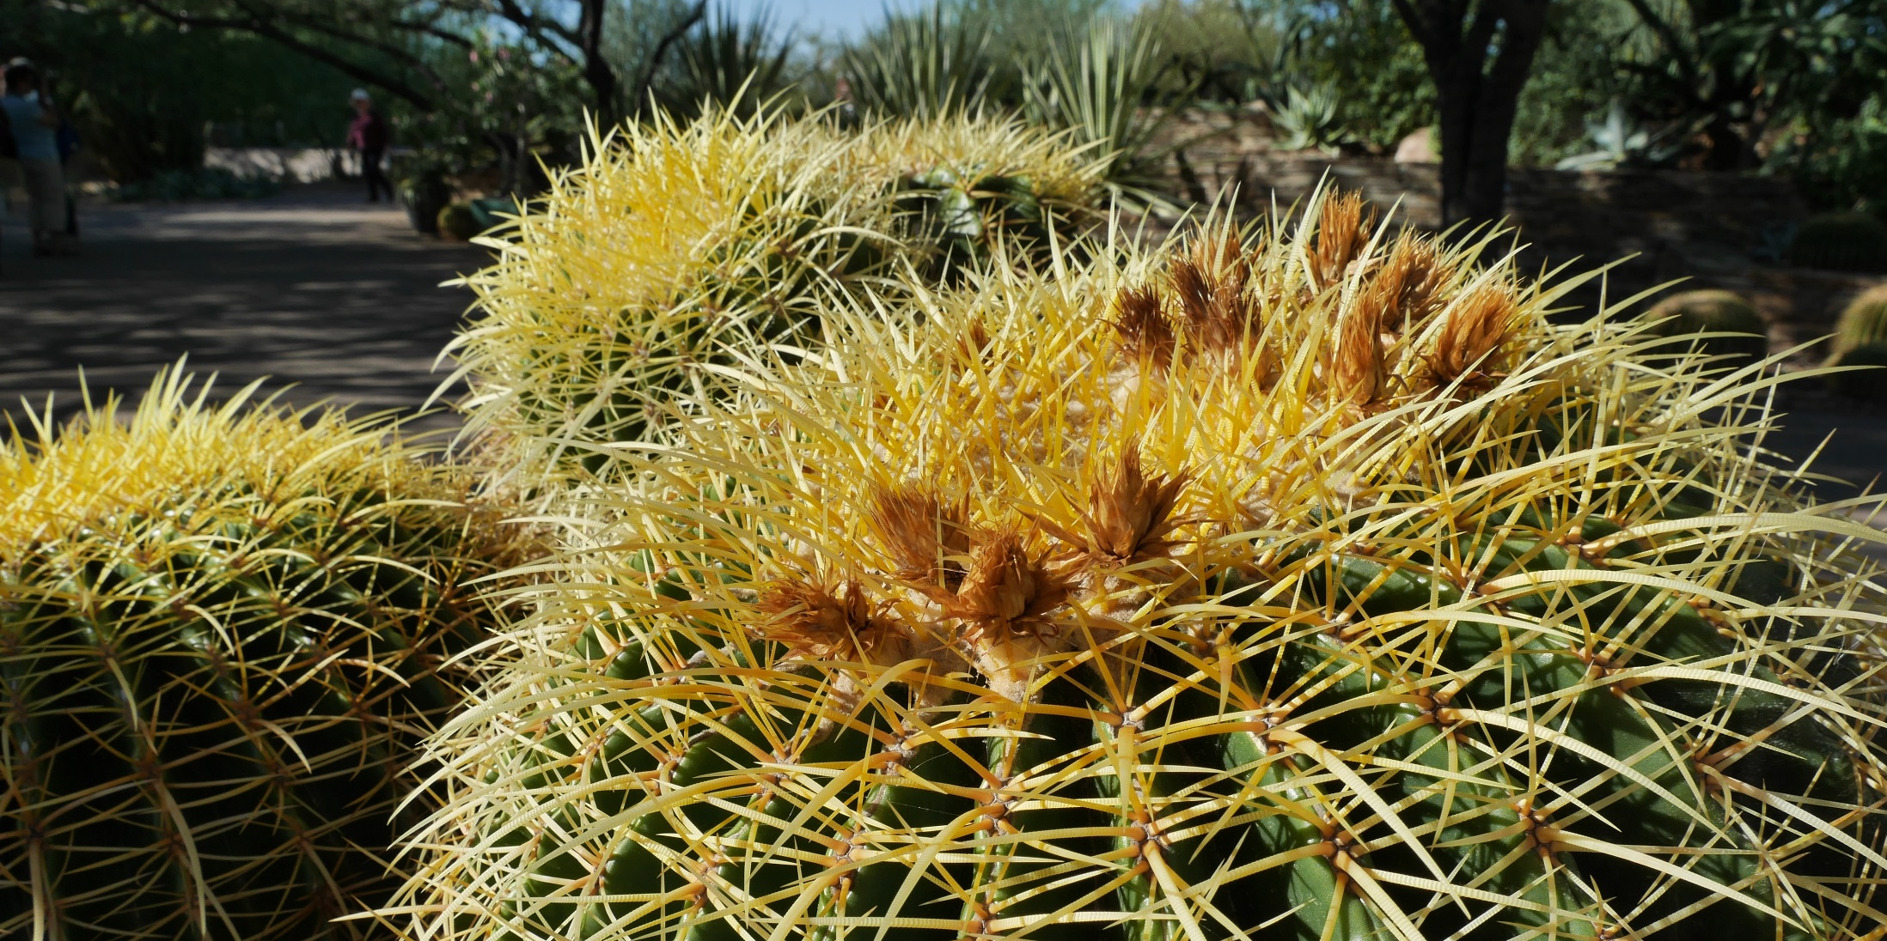
Update of Facebook @GRAcroplands
GRA-Cropland annual meeting 2016
Nov. 10, 2016
@Phoenix, AZ, USA
Ayaka Kishimoto-Mo
NIAES
Japan
mow@affrc.go.jp

Slide 2
https://www.facebook.com/gracroplands/
March, 2015~
73 Likes
Maximum “Reach”
175
Contents:
Group activities
GRA news and outcome
Member countries activities (Multi-langueges)
IPCC, UNFCCC, FAO news and outcome

Slide 3
The most “Reach” post

Slide 4
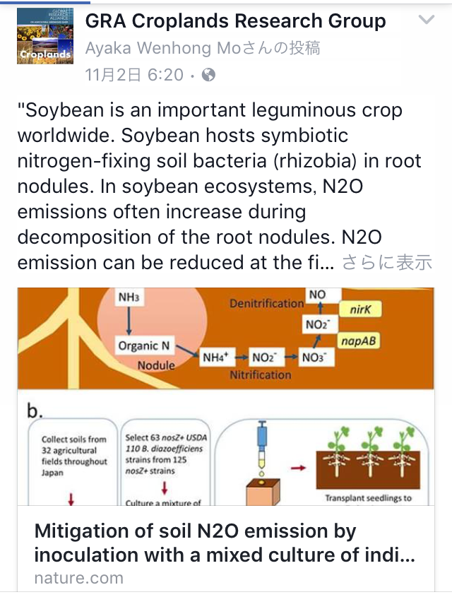
Suggestion for actions
https://www.facebook.com/gracroplands/
Join Facebook page
Post/share the new publications, new findings from your country (if possible, bilanguage!)
Reaction to posts/shares

