Slide 1
Partnerships and Links to Policy

Slide 2
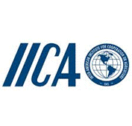
Partners of the GRA

Slide 3
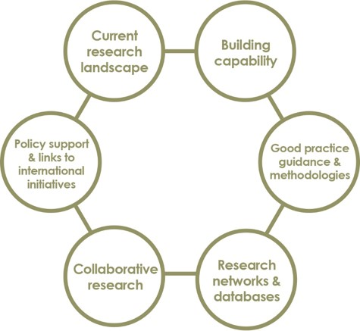
Workplan of the CRG

Slide 4
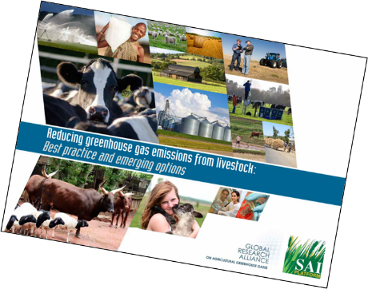
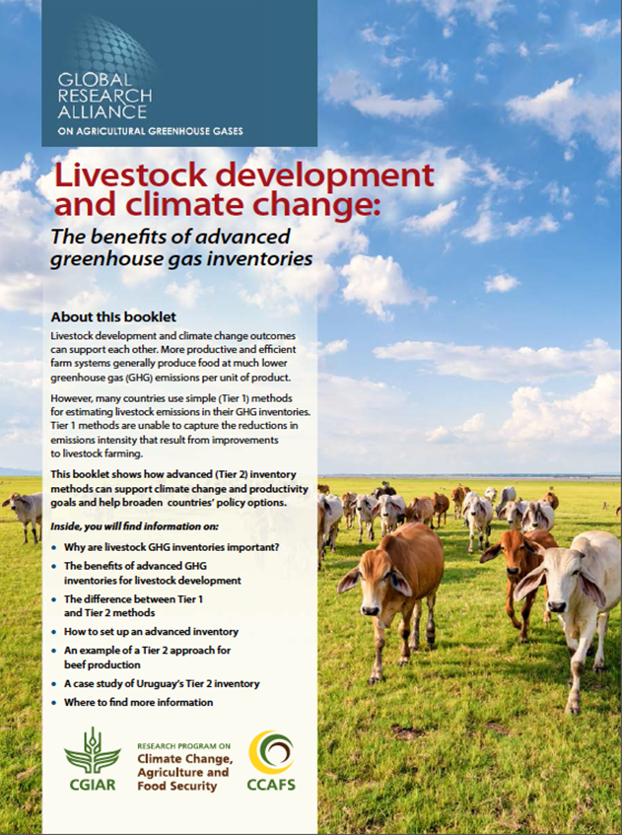
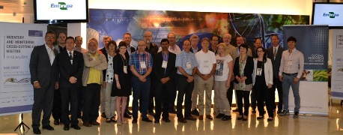
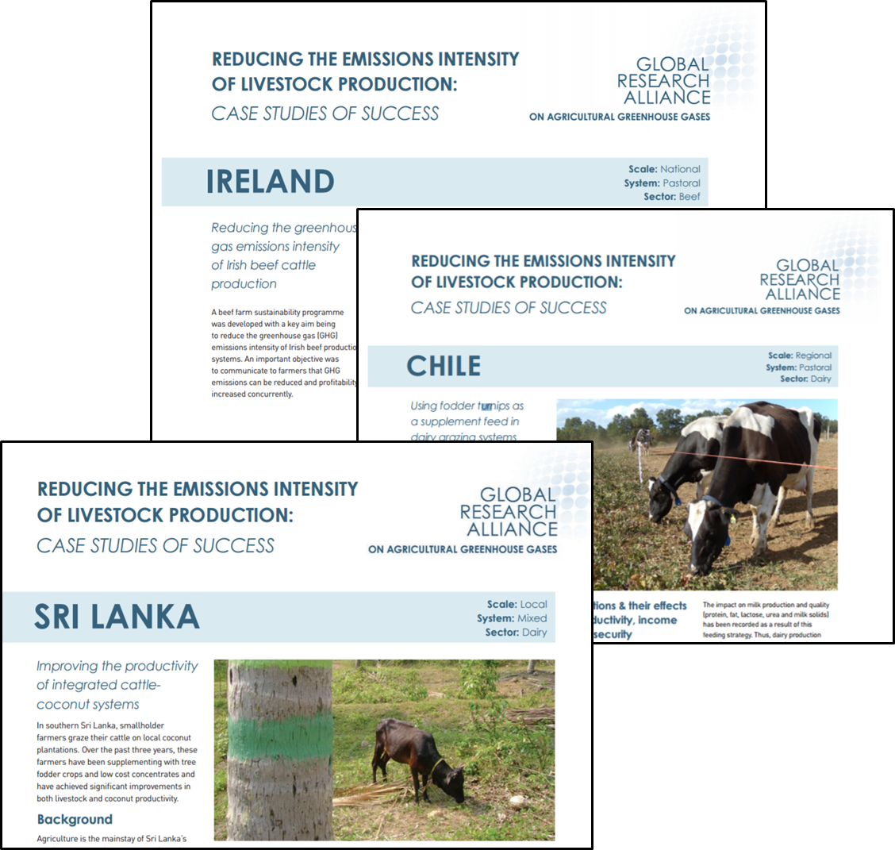
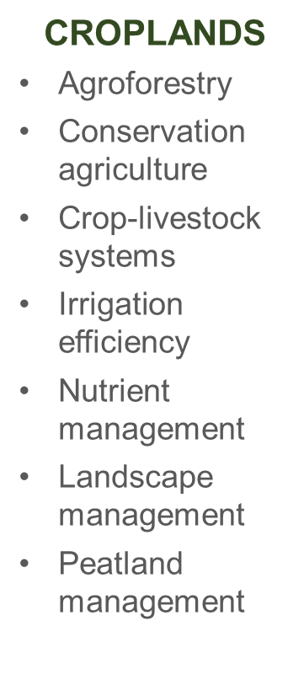
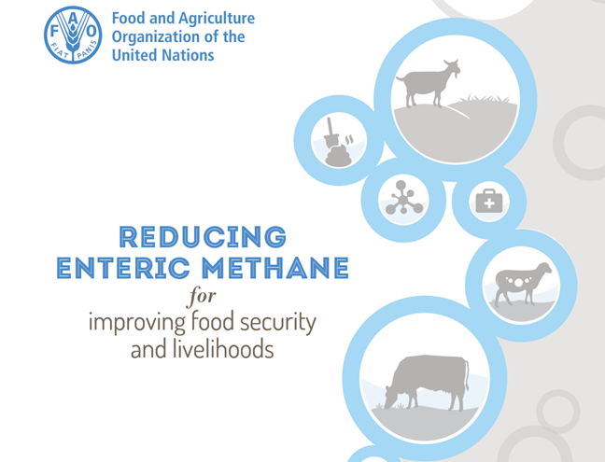
Supporting the CRG’s ambition

Slide 5
Potential CRG partners
CABI
CGIAR- CCAFS
Sustainable Agriculture Initiative (SAI) Platform
International Fertiliser Industry Association
CIMMYT – International Maize and Wheat Improvement Centre

