Slide 1
Research Group
Co-chairs’ Report
Martin Scholten, Harry Clark, Kazuyuki Yagi, Gonzalo Zorrilla, Jane Johnson, Ladislau Martin-Neto, Rosa Mosquera-Losada, Jean-Francois Soussana, Brian McConkey, Lee Nelson
GRA Council meeting, Tsukuba
29 October 2017

Slide 2
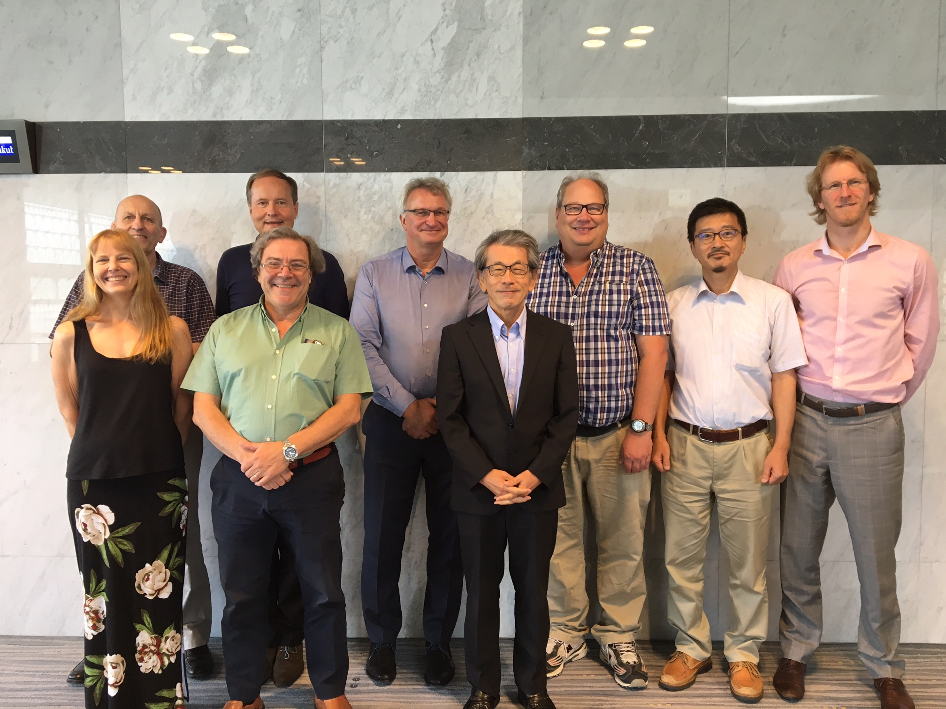
Team of Co-Chairs with Chair 2017

Slide 3
Research Groups

Slide 4
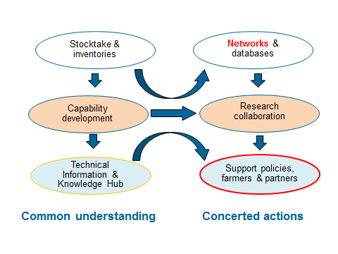
Outline of Work 2011-2016

Slide 5
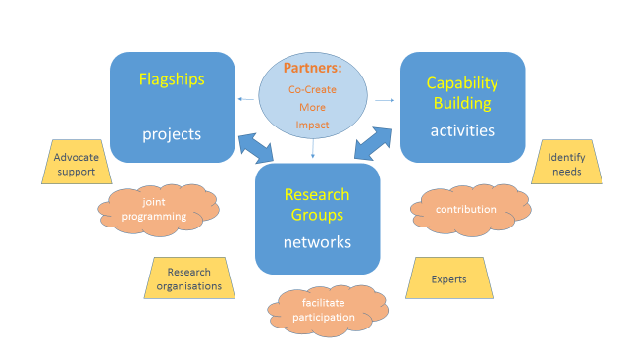
Outline of Work updated 2017+

Slide 6
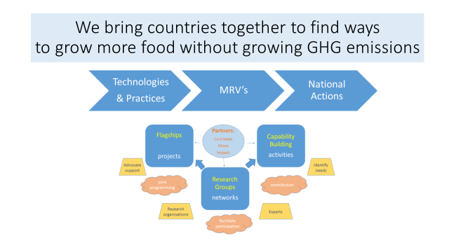
Impact driven!

Slide 7
GRA Council meeting, Tsukuba
29 August 2017
Joint Research Group Recommendations

Slide 8
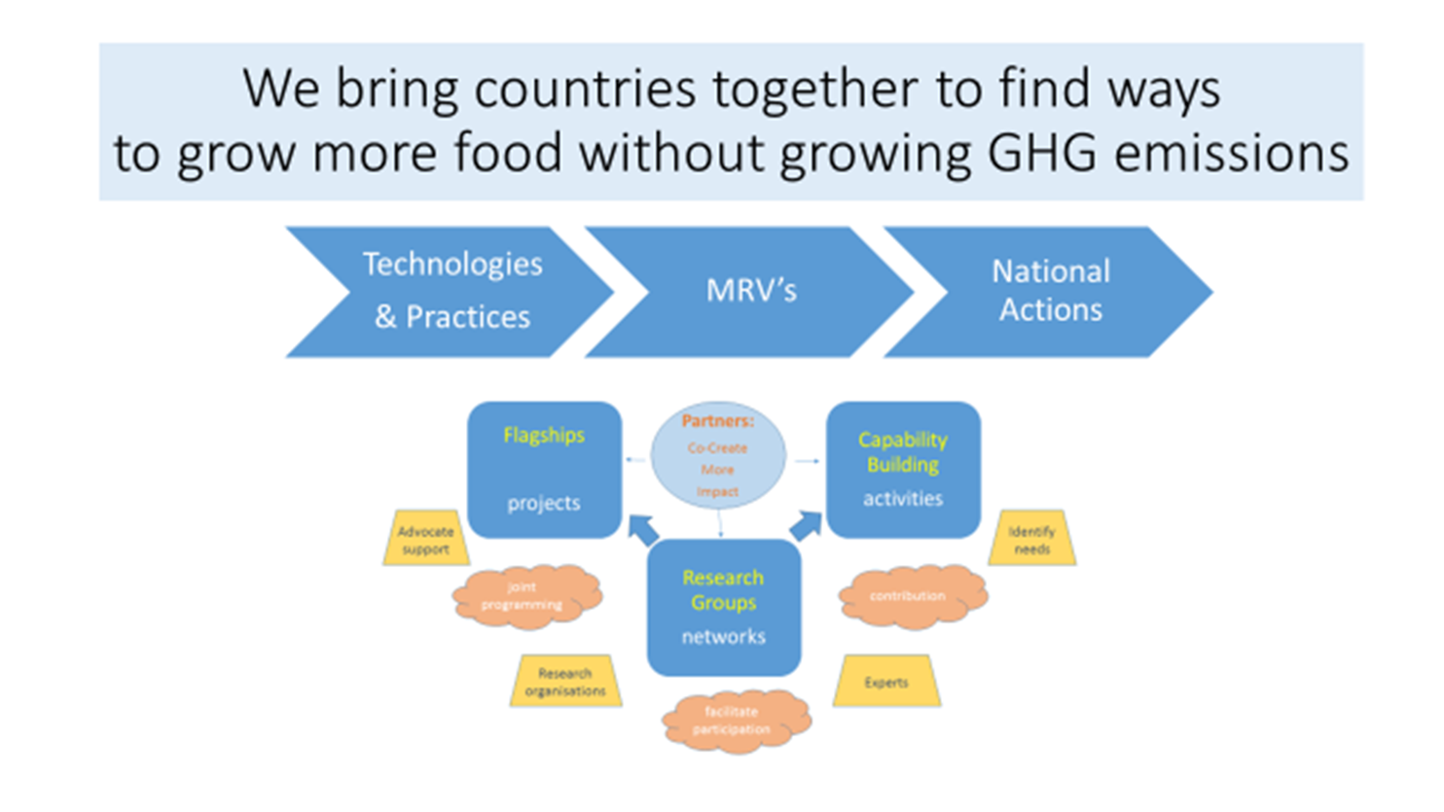
Research Group requests to Council
Supporting the Co-Chairs & Networks
Acknowledge the support already provided by those countries undertaking co-chairing roles
Increased membership & responsibilities (e.g. flagships) is placing increasing demands on the co-chairs’ time. For some co-chairs the workload is becoming unsustainable
Provide time & staff & budget to co-chairs; concept of co-chair ‘teams’ not just co-chairs
The Livestock & Paddy Rice Group want to move to a tri-chairing arrangement; please consider volunteering to take up this role & providing the necessary resources
Help make the RGs’ stronger
Facilitate research organization to join networks
Facilitate experts to join networks
Arrange and host facilities for regional hubs

Slide 9
Research Group requests to Council
Supporting Flagship’s
Co-chairs enthusiastically endorse the concept of flagships
The development of resourcing mechanisms is critical for success of the flagships; GHG Nexus & Circasa initiative need to be supported
The co-chairs urge Members to
Further develop joint programming initiatives
Support Flagship proposals in competitive calls
Provide direct support for involvement in flagships
Suggest new flagship projects, especially those that can build on existing multi-partner initiatives

Slide 10
Research Group requests to Council
Supporting Capability Building
Understanding ‘need’ is critical and is especially important now due to the influx of new Members.
Co-chairs will work with the Secretariat to develop an inventory of needs; your involvement is critical if we are to better deliver to your needs
Resourcing is critical for the RGs to undertake capability development – too few Member countries are providing the resources necessary for all RGs to undertake capability building activities (LRG is an exception & acknowledges strong NZ support)
Research groups working to develop a more integrated cross-group approach to capability building e.g. regional workshops covering all aspects of MRV
You can help - facilitate the recruitment of experts & provide support; host meetings for GRA integrated workshops; provide fellowships to link capability development with flagship projects

Slide 11
Research Group requests to Partners
Co-create more Impact
Greater Partner involvement is critical especially for the success of flagship projects and capability building
GRA need to seek opportunities to co-create better global activities and programmes - partner & build on existing initiatives, co-develop new initiatives

Slide 12
Research Group requests to Council
Additional Questions
What is the status of a GRA Scientific Conference?
What is the status of support for the 4/1000 initiative?

Slide 13
DISCUSSION

