Slide 1


2 September 2017
SECRETARIAT UPDATE

Slide 3






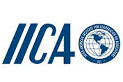








PARTNER ORGANISATIONS

Slide 4
Potential Partners
The Council agreed to re-issue invitations to the Asian Development Bank and International Fund for Agricultural Development to be partners of the GRA.
Accepted the request for partnership from the International Soil Reference and Information Centre (ISRIC).
Agreed to pursue partnerships with the following organisations:
Global Agri-business Alliance (GAA)
World Business Council on Sustainable Development (WBCSD)
Sustainable Agriculture Initiative Platform (SAI Platform)
International Fertiliser Development Centre (IFDC)
Caribbean Agricultural Research & Development Institute (CARDI)
Forum for Agricultural Research in Africa (FARA)

Slide 5
2017 COUNCIL MEETING OUTCOMES
Germany confirmed as vice –Chair
  Proposal to host a GRA Conference jointly with FACCE, alongside the 2018 Council meeting
Livestock and Paddy Rice Research Groups call for Members to support a 3rd Co-Chair of each Group.
Develop an inventory of capability building needs - and survey of capability fellowships and training events.
Research Groups proposed developing regional capability building activities, coordinated across all Groups.
Facilitate capability building support – including fellowships
Council Members to identify the Flagship projects they will support.

Slide 6
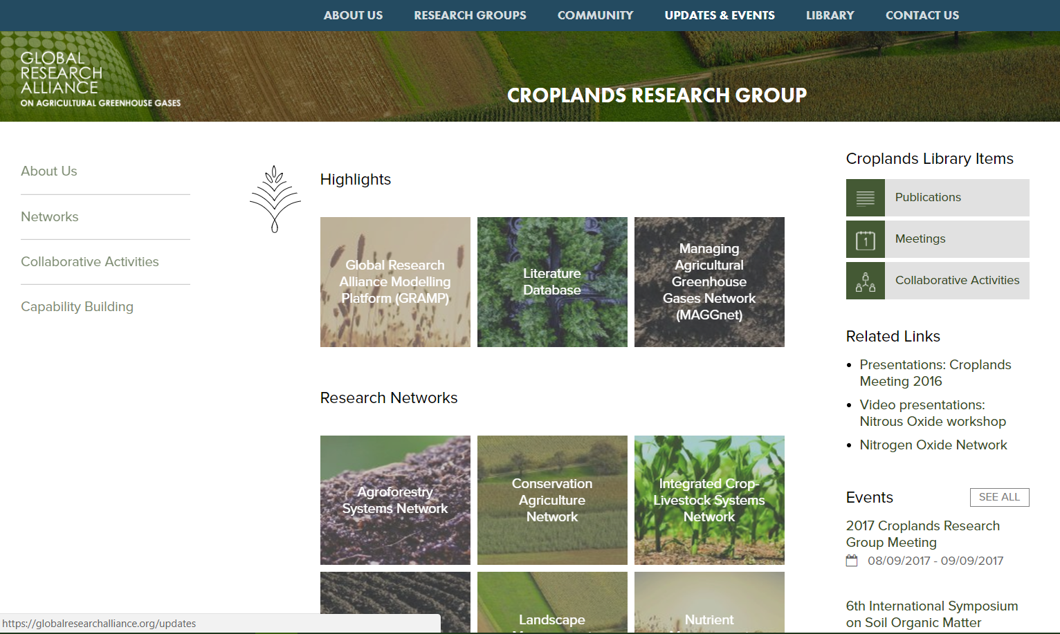
WEBSITE UPDATES
Expansion of Research Group Pages – to showcase Networks and activities

Slide 7
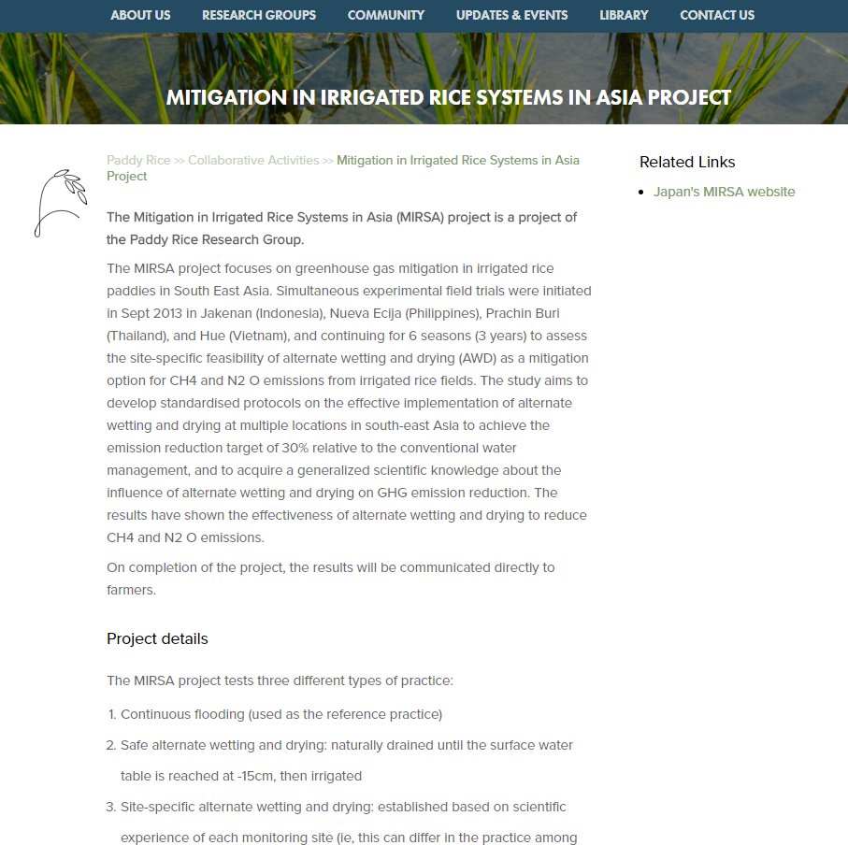
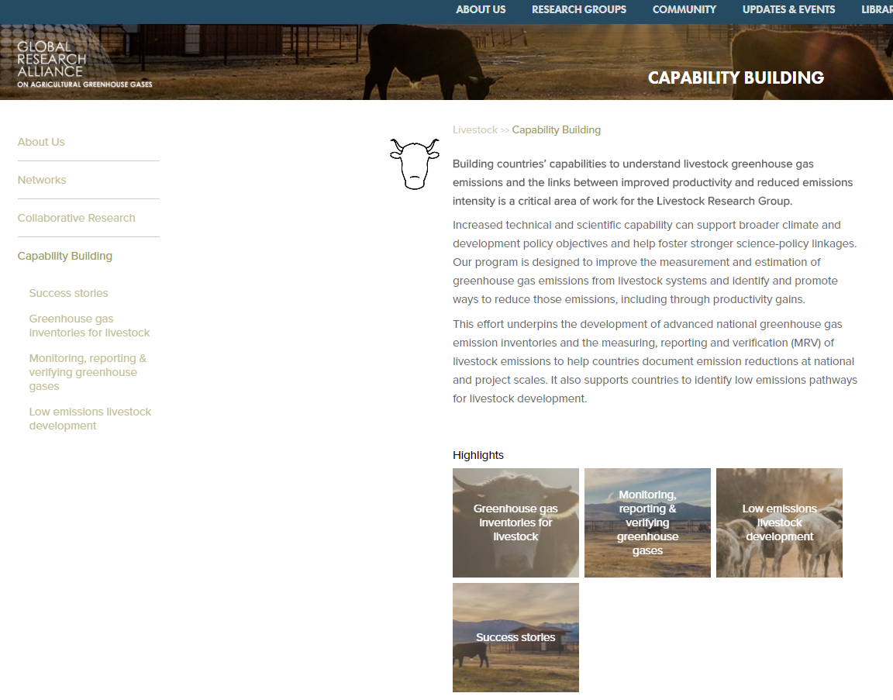
WEBSITE UPDATES
Highlight workplan elements and activities
Focus on priority projects

Slide 8
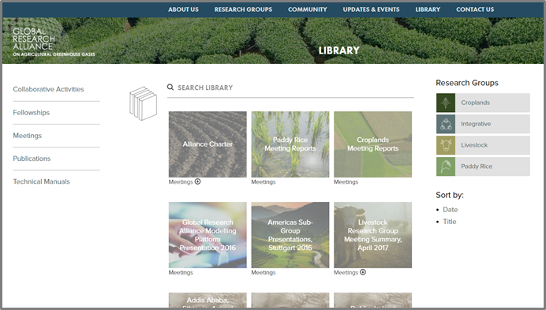
WEBSITE UPDATES
Resource Library – access publications, documents, fellowship opportunities and project information

Slide 9
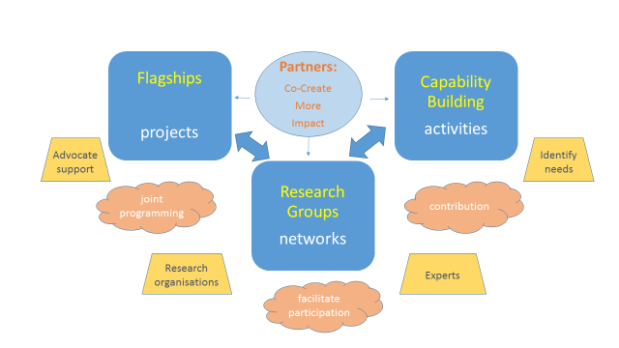
Outline of Work updated 2017+

Slide 10
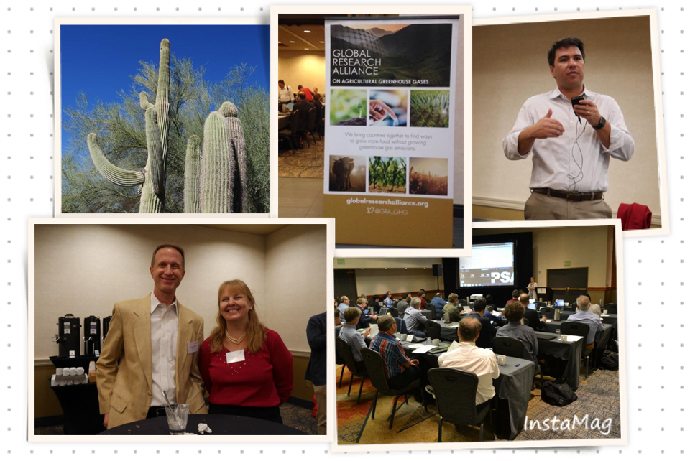

CROPLANDS RESEARCH GROUP
Co-Chairs
  Jane Johnson, USDA-ARS, USA
  Ladislau Martin, EMBRAPA, Brazil
  Rosa Mosquera, Spain
Group Activities
  Landscape management Network –
  Obtained funds - China and UNEP, granted by National Natural Science Foundation of China. (China and Kenya).
  Conservation Agriculture Network-published factsheet, obtained funds for meta data compilation.
  Proposal for a N2O “Asia Pacific Regional Network for Greenhouse Gases” (pending)
Next Meeting
  8 September, Hatfield, UK

Slide 11

LIVESTOCK RESEARCH GROUP
Co-Chairs
  Harry Clark, NZAGRC, New Zealand
  Martin Scholten, Wageningen UR, the Netherlands
Group Activities
Conclusion of stage 1 of project with FAO,CCAC, NZ - ‘Reducing enteric methane for improving food security and livelihoods’. Demonstrated options to reduce emissions intensity at the same time as increasing productivity in 13 countries.
  Regional training for South/South-East Asian countries
  White Paper on MRV of livestock GHGs
  Co-published an informative guide on the benefits of Tier 2 inventories to increase policy options (climate & agriculture)
Next Meeting
  May 2018, Vietnam

Slide 12

INTEGRATIVE RESEARCH GROUP
Co-Chairs
  Brian McConkey, Agriculture and Agri-Food Canada
  Lee Nelson, Department of Agriculture, Australia
  Jean-François Soussana, INRA, France
Group Activities
  Soil carbon network: C-MIP, testing soil carbon models on a global network of long-term bare fallow sites (launched)
  Field scale network: GHG-MIP, N₂O emissions and yields of crop rotations and grasslands at 10 sites across 4 continents.
  Farm-Region: global map showing organic carbon inputs to soils required to reach the 4 per 1000 target
  Coordination of international soil carbon sequestration research (CIRCASA) 17 countries.
  Next Meeting
  17-19 January 2018, Paris, France – including 1 day symposium.
Grasslands
Soil carbon
Field
Farm, region
Inventories

Slide 13
FOR MORE INFORMATION
www.globalresearchalliance.org
secretariat@globalresearchalliance.org
Twitter: @GRA_GHG

