Slide 1




Greenhouse Gas Mitigation in Irrigated Rice Paddies in Southeast Asia/ Part 2: Field Demonstration
2017 Dry Season Report
(7th Season Field Experiment)

Slide 2
Objective
To determine the effect of earlier rice residue incorporation and dry soil condition during fallow period in reducing further the CH₄ emission in combination with an earlier implementation of AWD.
( validate the 2016 DS field experiment)

Slide 3
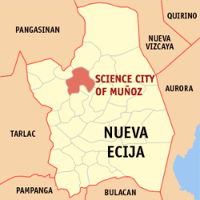
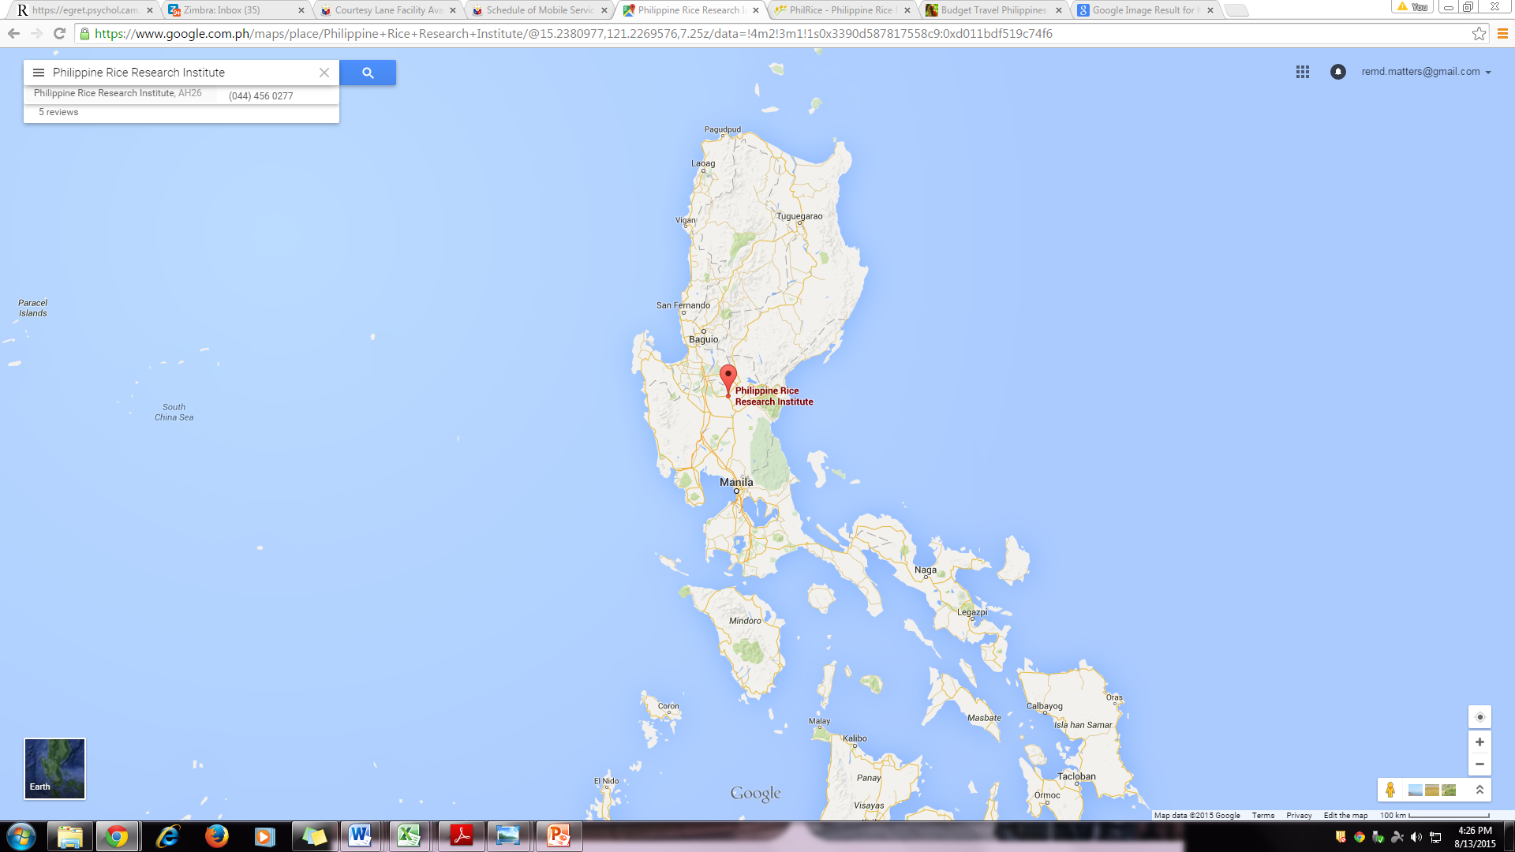
Site Location
Philippine Rice Research Institute
Central Experiment Station
Munoz, Nueva Ecija

Slide 4
Experimental Design
RCBD in 4 replications
Plot size : 6 x 6 m
3 Water Management (CF, AWD, AWDS)

Slide 5
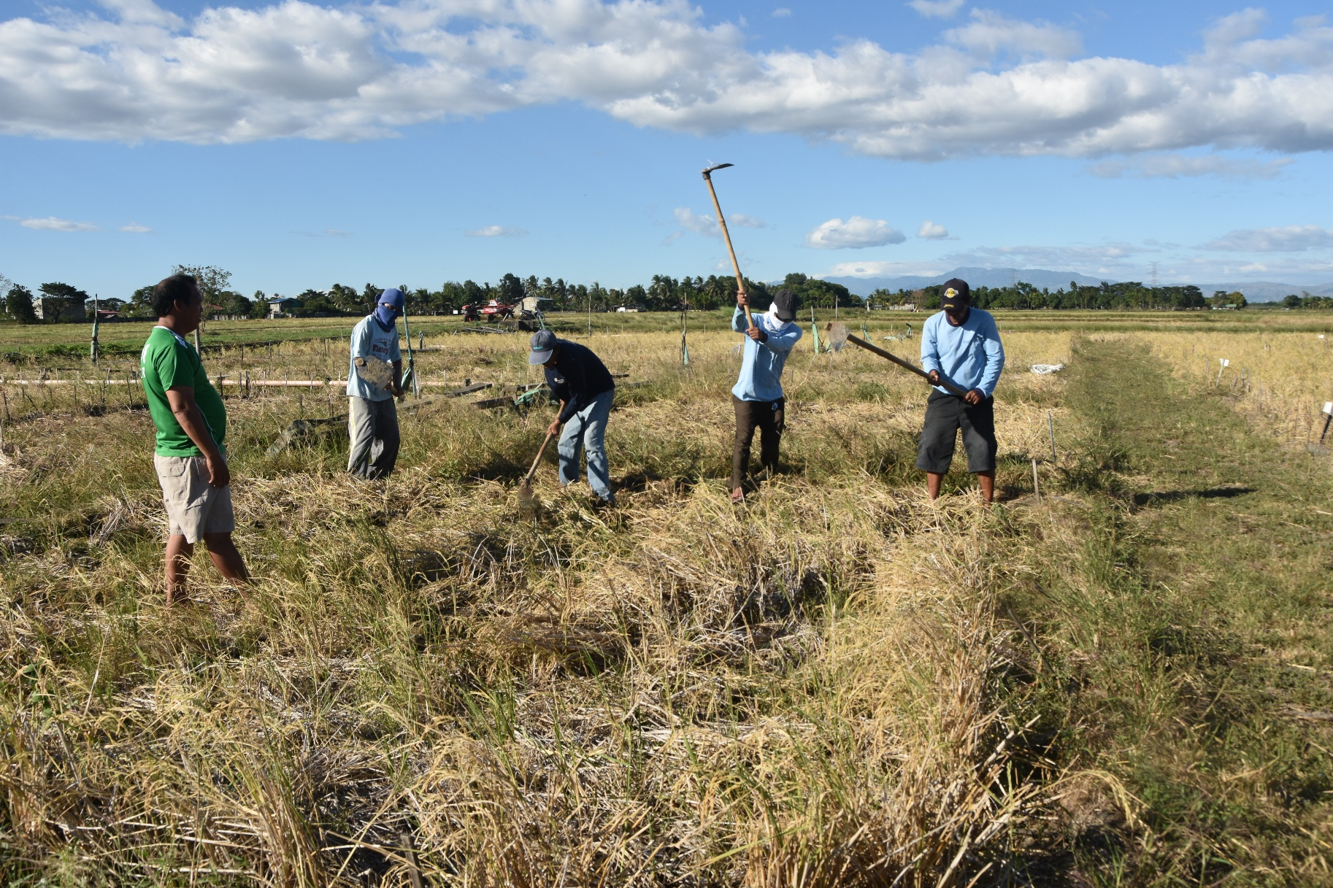
Field Management Practices, 2017 DS
Management | Details
Plowing date | 29-Dec-17
Variety | NSIC Rc238
No. seedlings/hill | 02-Mar
Transplanting date | 05-Jan-17
Harvesting date | 04-Apr-17
Pesticide/Herbicide Application | None
Total N (kg N ha⁻¹) | 120
Total K (kg K₂O ha⁻¹) | 40
Total P (kg P₂O5 ha⁻¹) | 40
Straw management | Incorporated rice stubbles during dry shallow tillage after harvest of the previous crop

Slide 6
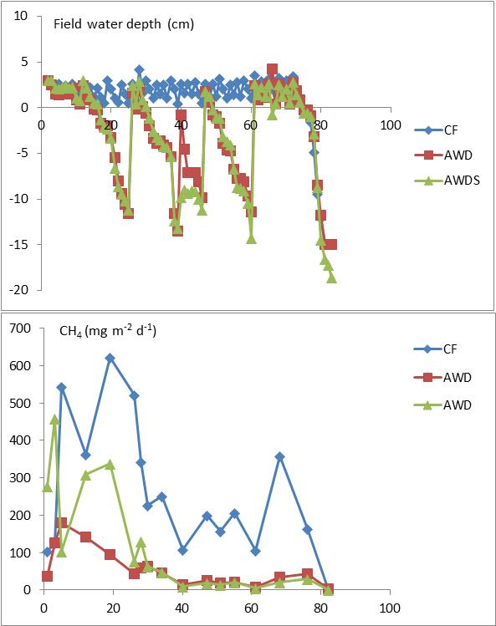
Methane Emissions
2016 DS
2017 DS
RF
RF

Slide 7
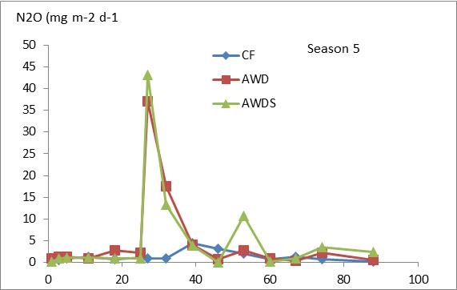
Nitrous Oxide Emissions
2016 DS
2017 DS
N application
N application

Slide 8
Seasonal emissions and GWP during 2017 DS
Treatments | CH₄ | N₂O | GWP
 | (kg CH₄ ha⁻¹) | (kg N₂O ha⁻¹) | (kg CO₂ eq ha⁻¹)
CF | 227.8 a | 2.84 a | 8591 a
AWD | 45.8 b | 2.52 a | 2307 b
AWDS | 82.7 b | 2.34 a | 3807 b
80%
64%
73%
56%
(CH₄ Reduction
relative to CF)
(GWP Reduction
relative to CF)
Means with different letter are significantly different (p<0.05)

Slide 9
Grain yields, water use and water productivity, 2017 DS
Treatments | Grain Yield | Total water use (Irrigation +rainfall) | Water Productivity
 | kg ha⁻¹ | m³ ha⁻¹ | kg m⁻³
CF | 6,838 a | 11,364 a | 1.29 a
AWD | 5,901 a | 5,331 b | 0.97 a
AWDS | 6,369 a | 4,795 b | 1.29 a
53%
58%
Means with different letter are significantly different (p<0.05)
(Water savings relative to CF)

Slide 10
Conclusions
Some high emissions were observed at the early vegetative stage due to rainfall, despite of the dry shallow tillage in the preceding fallow period.
The effect of water management was significant in the reduction of CH₄, with reduction rate by AWD and AWDS of 64-80% compared to CF;
The seasonal total N₂O emission was not significantly affected by water management.
The resultant GWP reduction was 56-73% by AWD and AWDS relative to CF;
Significant reduction on the water use while no significant yield loss.

Slide 11
Thank you.

