Slide 1

Site-specific feasibility of alternate wetting and drying as a greenhouse gas mitigation option in irrigated rice fields in
Southeast Asia: a synthesis
Agnes Tirol-Padre, Kazunori Minamikawa, Takeshi Tokida, Reiner Wassmann, and Kazuyuki Yagi

Slide 2
OBJECTIVES
Analyze the effects of environment and soil properties on the extent of GHG mitigation by AWD
Examine the potential trade-offs and co-benefits of AWD in terms of rice grain yield and water savings
Compare the measured site Emission Factors and Scaling Factors for CH₄ and N₂O under AWD, with the IPCC’s default values

Slide 3
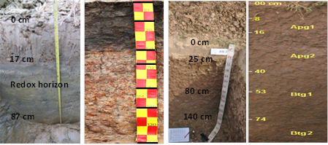
Inter-Site Variation in Soil Properties
CLAYEY SOILS
LOAMY SOILS
Hue, Vietnam
FAO: Ustic Epiaquert
USDA: Eutric Vertisol
Prachin Buri, Thailand
USDA: Vertic Endoaquepts,
Active, acid isohyperthermic sulfic Endoaquepts
Muñoz, Philippines
FAO: Dystric Fluvisols,
USDA: Typic Endoaquepts
Jakenan, Indonesia
USDA:
Aeric
Endoaquepts

Slide 4
Inter-Site Variation in Soil Properties
Site | Hue | Jakenan | Prachin Buri | Muñoz
pH | 4.18 | 6.46 | 4.93 | 6.44
Total C (g kg⁻¹) | 19.2 | 5.3 | 22.2 | 14.6
Total N (g kg⁻¹) | 1.90 | 0.47 | 1.80 | 1.23
C:N mole ratio | 11.9 | 13.3 | 14.5 | 14.6
Active Fe (g kg⁻¹) | 12.3 | 3.6 | 15.6 | 12.6
Active Mn (g kg⁻¹) | 0.03 | 0.05 | 0.07 | 0.68

Slide 5
Inter-Site Variation in AWD Implementation
Criteria used:
Minimum soil flood water level
Total number of non-flooded days (ponding water less than 0 cm) from seeding to final drainage
Ratio of number of non-flooded days to total crop duration (seeding to final drainage)
Average water level
$$SF={1.088∗∗ −0.0103NNF∗∗+0.0038MinWL∗ }^{}$$
Notes:
Some criteria were used to show the inter-site variability in AWD implementation
Stepwise selection for Multiple regression analysis: First 2 variables significantly explained the variability (41%) in CH4 emissions

Slide 6
Inter-Site Variation in AWD Implementation
Criteria | Water Mgt | Hue | Jakenan | Prachin Buri | Muñoz DS | Muñoz WS
Minimum water level (cm) | AWD | -18.3 (-25 to -8) | -23.1 (-46 to -11) | -12.5 (-15 to -4) | -13.9 (-15 to -13) | -9.5 (-12 to -6)
 | AWDS | -13.0 (-20 to -6) | -32.1 (-64 to -19) | -13.0 (-15 to -6) | -133 (-19 to -7) | -8.6 (-9 to -8)
No. of non-flooded days | AWD | 30.2 (22 to 39) | 30.7 (20 to 41) | 24.3 (20 to 27) | 34 (24 to 45) | 10.5 (4 to 17)
 | AWDS | 29.3 (14 to 36) | 27.2 (14 to 44) | 13.3 (8 to 17) | 31.7 (12 to 50) | 6.0 (4 to 8)
Drainability |  | 0.94 ±0.28 | 1.85 ±0.28 | 0.78 ±0.29 | 0.67 ±0.24

Slide 7
Analyses of variance
Source of Variation | CH4 | N2O | GWP | Grain yield | Yield-scaled GWP | Water use
Site (S) | *** | *** | *** | *** | *** | ***
Dry or Wet (DW) | ** | ns | ** | ns | ** | ***
Water mgmt (WM) | *** | ns | ** | ns | ns | ***
S × DW | *** | *** | *** | *** | *** | ***
WM × S | ns | ns | * | ns | † | ***
WM × DW | ns | ns | ns | ns | ns | ns
WM×DW×S | ns | ns | ns | ns | ns | *

Slide 8
Changes under AWD relative to CF
Site | Season | Hue | Jakenan | Prachin Buri | Muñoz
CH₄ (%) | DS | -25.8 | -36.7 | -31.2 | -32.1
 | WS | -23.8 | -36.8 | - | 14.1
GWP (kg CO₂ eq ha⁻¹) | DS | -30.8 | -36.3 | -11.5 | -11.4
 | WS | -24.8 | -35.9 | - | 14.0
Water Use (m³ ha⁻¹) | DS | -14.4 | -6.4 | -29.8 | -47.1
 | WS | -14.9 | -5.7 | - | -17.0
Water Productivity (kg grain m⁻³ | DS | 30.1 | 4.6 | 17.6 | 69.0
 | WS | 25.6 | 3.3 | - | 22.2

Slide 9
CH₄ Emission Factors and Scaling Factors for AWD
Weighted means +/- bootstrapped confidence intervals
Weighted means +/- bootstrapped confidence intervals
Notes:
Bootstrapping, a computational nonparametric technique for" re-sampling," enables
researchers to draw a conclusion about the characteristics of a population strictly from the
existing sample rather than by making parametric assumptions about the estimator.
Bootstrap as an alternative to the parametric estimation of moderation effects in the presence of skewed dependent variables.

Slide 10
N₂O Emission Factors
EF was calculated by subtracting the mean background N₂O emission from Akiyama et al., 2005

Slide 11
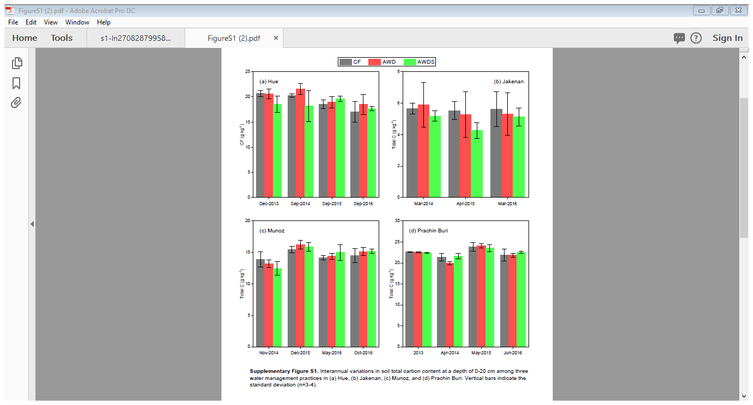
Inter-annual variation in soil carbon contents
Soil depth: 0-20 cm
Error bars: std deviation

Slide 12
Highlights
CH₄ emissions varied significantly (P<0.05) among sites, seasons and water management.
N₂O emissions were not significantly (P<0.05) affected by water management but considerable increases under AWD relative to CF were observed in Muñoz, and Prachin Buri during the DS.
AWD successfully reduced the seasonal CH₄ emission and GWP at varying levels: 25 and 28 % in Hue, 37 and 36 % in Jakenan, 31 and 11 % in Prachin Buri DS, and 32 and 11 % in Muñoz DS.

Slide 13
Highlights
AWD was not effective in the clayey soils of Muñoz and Prachin Buri during WS due to the frequent rainfall & the slow water percolation; but it was effective during WS and DS in Hue and Jakenan, both of which had loamy soils and relatively faster percolation rates.
The acid sulfate soil primarily contributed to low CH₄ emissions in Prachin Buri
High soil Mn content may have contributed to the low CH₄ emissions during DS in Muñoz

Slide 14
Highlights
AWD effectively reduced water use compared to continuous flooding (CF) but did not significantly (P < 0.05) reduce rice grain yield (even with the more drastic AWD in Hue and Jakenan) and soil carbon content in the top soil in all sites.
The reduction in water use through AWD relative to CF was remarkably higher in the clayey soils of Muñoz during DS (47%) and Prachin Buri DS (30%) than in the loamy soils of Hue (15%) and Jakenan (6%).
High water savings through AWD do not always translate to high CH₄ emission reduction due to a greater influence of soil properties.

Slide 15
Highlights
The weighted mean CH₄-EF for CF and AWD in Hue and Jakenan were significantly higher than those in Muñoz DS and Prachin Buri.
The weighted-mean CH₄-EF under CF across sites and seasons including Muñoz WS (2.46 ± 0.56 kg ha-1 d-1) was higher although not significantly different from the IPCC’s default EF for flooded rice (1.30 kg ha⁻¹ d⁻¹) partly because they were obtained under site-specific management practices e.g. incorporation of FYM in Jakenan.

Slide 16
Highlights
The ratio of seasonal cumulative N₂O-N emission to the inorganic fertilizer N applied across sites was 0.42% under CF and 0.49% under AWD, comparable to those reported by Akiyama et al. (0.38 ± 0.41% under CF and 0.67 ± 0.22% under midseason drainage).
The AWD SF obtained for CH₄ did not significantly differ among sites, with a weighted mean of 0.69 ranging from 0.57 to 0.84 (excluding Muñoz WS). This was slightly higher but not significantly different from the IPCC’s default SF for multiple aeration of 0.52

Slide 17
Highlights
Using data from Hue and Jakenan, multiple regression analysis with stepwise selection showed that Minimum Water Level (MinWL) and Number of Non-flooded Days (NNFD) significantly influenced the variability in AWD SFs accounting for 41% of total variability.
Based on predicted SFs, a 30% reduction (SF=0.70) in CH₄ emission can be achieved with NNFD ≥ 32 when the MinWL = -15 cm for the loamy soils of Hue and Jakenan.

Slide 18
Thank you very much for your attention !!!

Slide 19
