Slide 1
Croplands Research Group
Co-Chairs’ Report
María Rosa Mosquera-Losada, Ladislau Martin-Neto and Hero Gollany
GRA Council meeting, Online
11 September 2024

Slide 2
CROPLANDS RESEARCH GROUP
RECENT ACTIVITES:
Four webinars this year. The last webinar for the year from Spain will be on September 19, 2024. Agroecology and Policy, Balancing Climate Change.
Two or more Nutrient Practices
Webinar in June 2024: “Stacking 4R Practices with Conservation Agriculture to Mitigate Nitrous Oxide Emissions”. Craig Drury, Agriculture & Agri-Food Canada, and Diego Abalos, Aarhus University, Department of Agroecology, Denmark).
NH3 NH3
N2O N2O
N2O
NO NO
N2 N2
NO3- NO3-
Drury et al., 2024
Webinar in March 2024: “Co-benefits and Tradeoffs of Agricultural Mitigation and Adaptation in Rice Based Cropping Systems” CRG & AgMIP (Roberto Valdivia, Oregon State University, USA, Sonali McDermid, New York University, NASA-GISS, USA, Tao Li, International Rice Research Institute, IRRI, Philippines, and Erik Mencos, Columbia University, NASA-GISS, USA).
Notes:
For June webinar we had 153 registered, 48 attended, 20 from USA.

Slide 3

CROPLANDS RESEARCH GROUP
RECENT ACTIVITES:
Procinorte online 2024 American Workshop on Soil, Water, and Climate Change: Can Models Guide Our Way. March 14, 2024. Hero Gollany presented “Research on Field Scale Soil Organic Carbon Modeling Using Long-Term Agricultural Experiments and the Process-Based CQESTR Model.
IPCC Scoping Meeting (February 26-28, 2024). Xunhua Zheng, Institute of Atmospheric Physics (IAP), Chinese Academy of Sciences and Landscape Management of Agricultural System Network (LMAS) network reported on Short-lived Climate Forcers (SLCFs) in Brisbane, Australia.

Slide 4
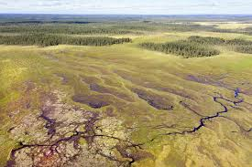
CROPLANDS RESEARCH GROUP
RECENT ACTIVITES:
A workshop on “Knowledge Gaps in Emission Reporting on cultivated organic soils and managed peatlands”, November 2023: Simon Weldon, NIBIO, Norway, Fahmuddin Agus, BRIN, Indonesia and Junbin Zhao, NIBIO, Norway).
Webinar in November 2023: “Greenhouse Gas Balance of Peatland: Lessons from the Tropics and the North. Fahmuddin Agus, BRIN, Indonesia and Junbin Zhao, NIBIO, Norway).
NOAA
The high-resolution process-oriented hydro-biogeochemical model CNMM-DNDC, a core working model for the Landscape Management of Agricultural System Network, was chosen as a working model for a newly granted NSFC. Xunhua Zheng

Slide 5
CROPLANDS RESEARCH GROUP
RECENT ACTIVITES:
Capacity Buliding
Hosted 4 CLIFF-GRADS students at USDA-ARS, in Pendleton, OR, USA: Hero Gollany, hosted Bethel Geremew (Ethiopia) and Husaain Tajamul (Pakistan) and were trained on CQESTR carbon model. Primitiva Andrea Mboyerwa (Tanzania) and Mercedes Busto (Argentina) were trained on GHG emissions measurement.
Alice Budai and Thiago M. Inagaki at NIBIO, Norway are hosting a CLIFF-GRADS Jane Omenda (Kenya). Focus on the production of biochar-based fertilizers.
Thiago M. Inagaki and Eva Farkas are hosting Inviolata Lusweti (Kenya), and Junbin Zhao (NIBIO, Norway) and Carla Stadler (CIFCEN, Argentina) are also involved in GHG measurements and relevant data processing/analysis.

Slide 6
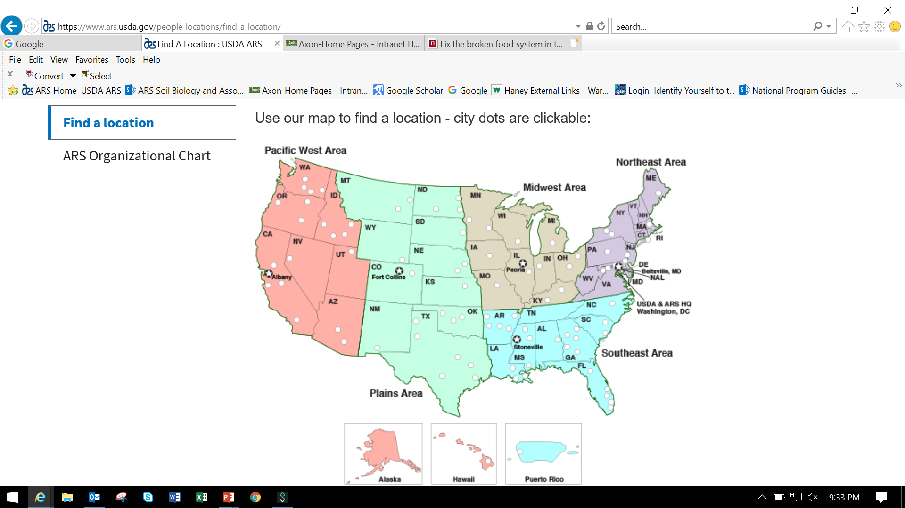
CROPLANDS RESEARCH GROUP
RECENT ACHIEVEMENTS:
USA-USDA-The Inflation Reduction Act (IRA)
NRCS provided $300 M to measure, evaluate, quantify carbon sequestration and greenhouse gas (GHG) emissions across USA.
USDA-NRCS provided some funding to USDA-Agricultural Research Service (ARS) scientists to develop GHG Research Networks across the USA (5 regions) to measure and model GHGs.
Hero Gollany is monitoring GHG emissions from annual cropping systems in the semiarid Pacific West.
Land Emissions
Enteric Methane
Animal Housing
Tall Towers

Slide 7
CROPLANDS RESEARCH GROUP
RECENT ACHIEVEMENTS:
USA – USDA NIFA
The USDA National Institute of Food and Agriculture (NIFA) provided ~$220 million in FY23 funds for competitive and capacity projects to support climate change-related research, education, and Extension.
NIFA launched in partnership with the National Science Foundation institute hosted at U of Minnesota - AI Climate, Artificial Institute for Climate-Land Interactions, Mitigation, Adaptation, Tradeoffs and Economy
NIFA continues to expand support for climate change related work through the Agriculture and Food Research Initiative

Slide 8
CROPLANDS RESEARCH GROUP
RECENT ACHIEVEMENTS:
USA – USDA NIFA (cont.)
Regional Innovation and Demonstration of Climate-Smart Agriculture for Future Farms funded two projects focused on advanced, precision technologies that reduce GHG emissions
Extension, Education & USDA Climate Hubs Partnership Program supports collaborations between USDA’s 11 Regional Climate Hubs and Cooperative Extension
NIFA supported National Climate Change Roadmap: A Research Framework for Agriculture, Forestry, and Working Lands to inform the next decade of climate-smart agricultural research and education

Slide 9
Thank you for your kind attention!
GRA Council meeting, Online
11 September 2024
Hero Gollany/United States, hero.gollany@usda.gov)

