Slide 1
Dr Harry Clark
Special Representative Update
GRA Council 11 September 2024

Slide 2
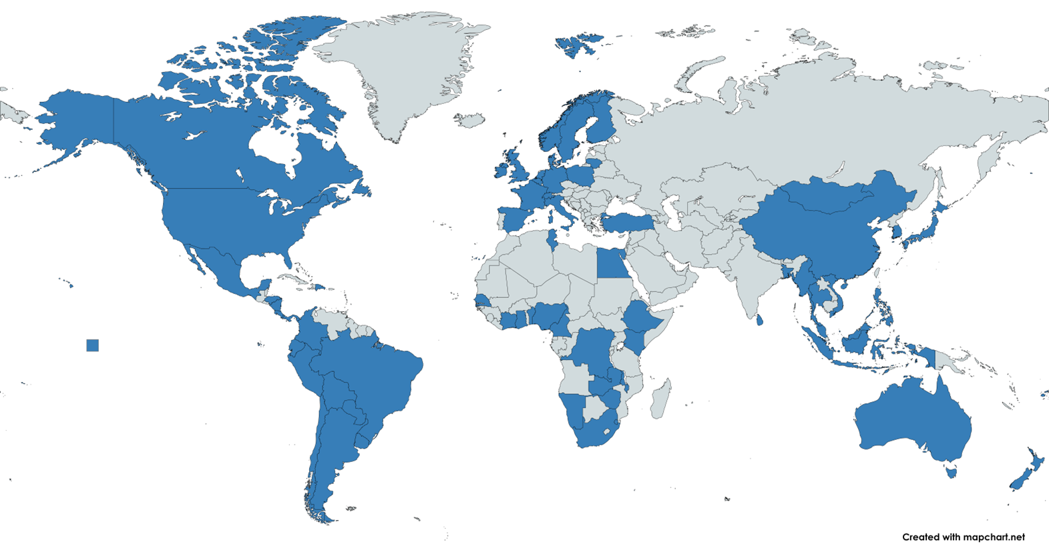
GRA Members
68 Member Countries
Tonga
Joined: January 2024

Slide 3
GRA Partners
In Discussion
Programa Cooperativo para el Desarrollo Tecnológico Agroalimentario y AgroIndustrial
Southeast Asian Regional Center for Graduate Study and Research in Agriculture
Pacific Regional Environment Programme

Slide 4
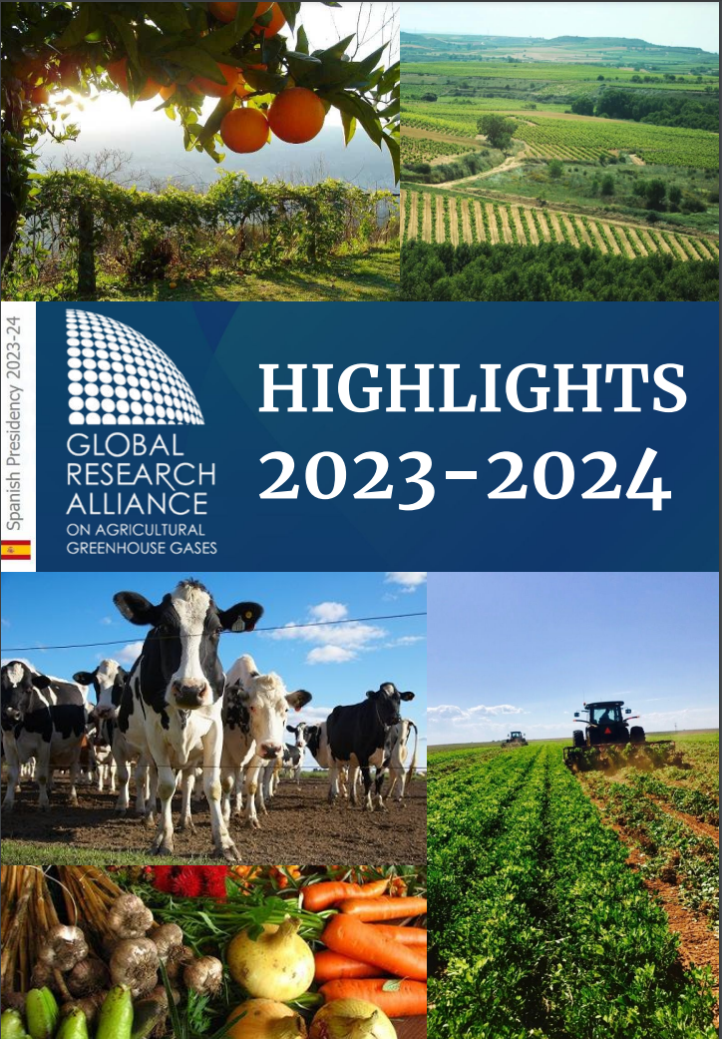
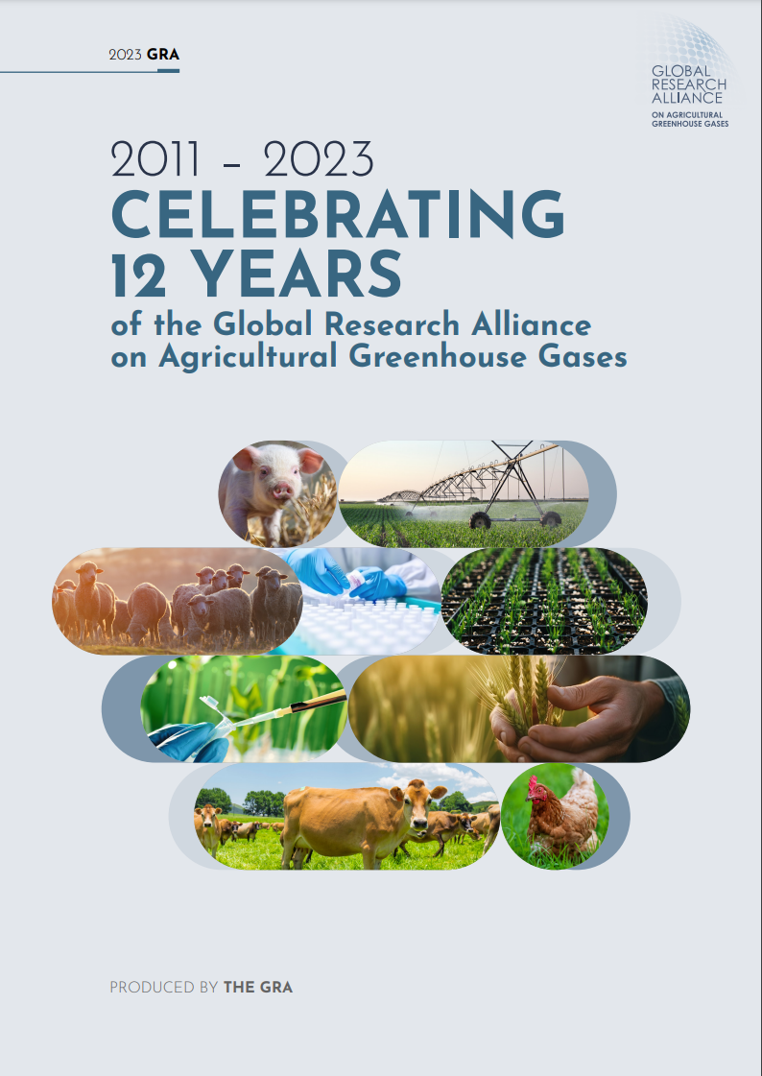
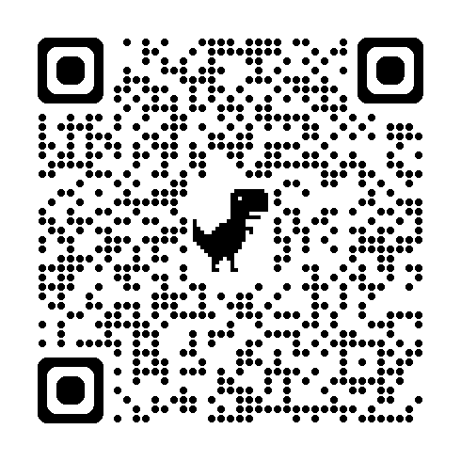
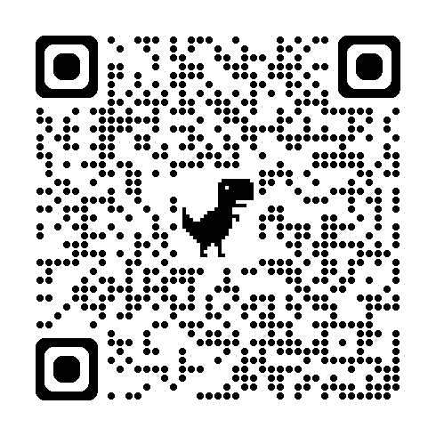
GRA Publications
To read the report, scan the QR code above or click here.
Annual Report
Research Stocktake
To read the report, scan the QR code above or click here.
Inaugural annual report of the GRA with highlights & updates from:
Research Groups
Flagship Projects
Capability building programmes
Publications
Highlighting:
Research projects
Publications
Events
Over the past 12 years.

Slide 5
GRA Scholarships
CLIFF-GRADS
Climate, Food and Farming, Global Research Alliance Development Scholarships Programme
Aim: to build the capability of PhD students from low- and middle-income countries to conduct applied research in agricultural greenhouse gas emissions quantification and mitigation.
A joint initiative of the GRA & CGIAR’s Mitigate+ Initiative, this programme offers grants to PhD students from low- and middle-income countries to conduct applied research in agriculture greenhouse gas emission quantification and mitigation.
More than 200 PhD students have received awards since 2017
Round 6 - 39 students are at different stages of their research stays
Round 7 - will launch in 2025
Join the programme’s new LinkedIn page to learn more about the achievements of our scholars.

Slide 6
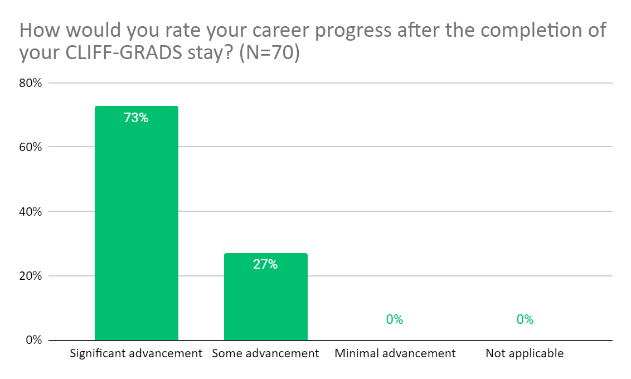
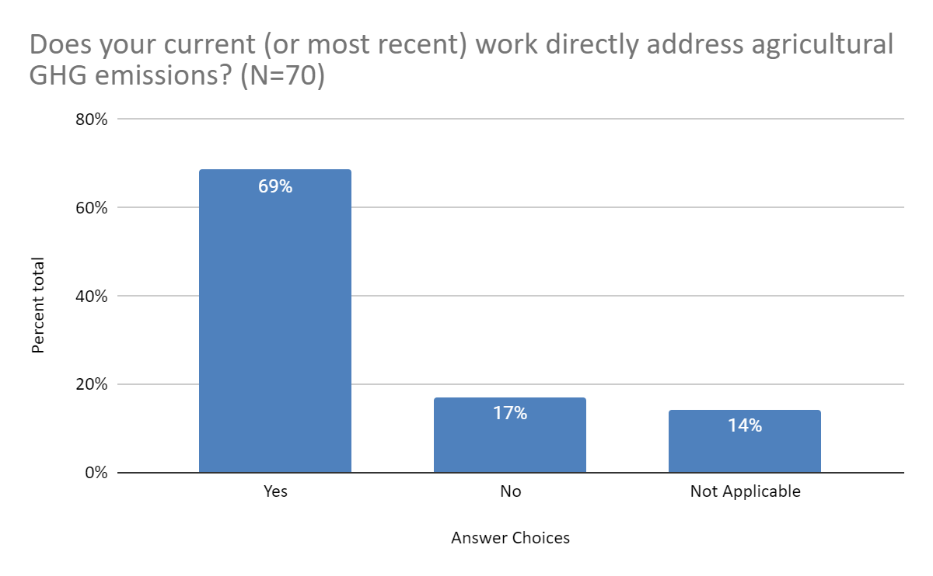
GRA Scholarships
CLIFF-GRADS
Climate, Food and Farming, Global Research Alliance Development Scholarships Programme
Conducted an online survey to assess the impact of the programme in supporting the career of the CLIFF-GRADS alumni.

Slide 7
GRA Scholarships
RUFORUM GRA Graduate Research Grants
Aim: to build the capability of graduate students and post-graduate scientists in Africa to conduct applied research on agricultural GHGs
A joint initiative of the GRA & the Regional Universities Forum for Capacity Building in Agriculture (RUFORUM).
Round 2 :
8 projects supported, each project will train 2 master’s students
2 PhD projects supported in collaboration with ILRI
In November 2023, during the RUFORUM annual technical committee, five
recipients of the first Round of the GRA-GRG Programme launched the
GRA-RUFORUM Alumni Network named GRAN-Afrique.
Notes:
This network aims at promoting networking among the Alumni, promoting the development of their professional careers, building their involvement and commitment in GRA and RUFORUM activities and facilitating cooperation in agricultural GHG research and development, including through community projects.

Slide 8
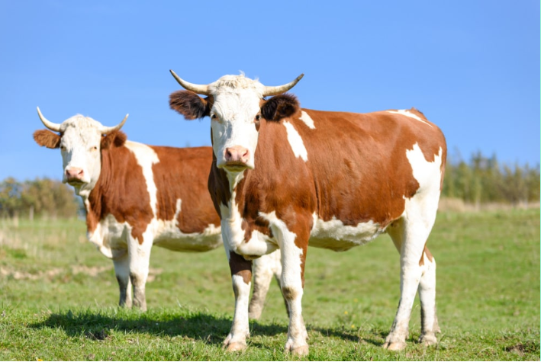
Participation alongside GRA Partner, the Global Methane Hub, in the Greener Cattle Initiative.
Round 1 has provided crucial support to innovative projects such as accelerating methane mitigation via animal breeding and searching for approaches that combine mitigation of enteric methane with improved animal performance.
Round 2 projects being assessed.

Slide 9
Global Dairy Platform: Pathways to Dairy Net Zero (P2DNZ)
Completed project quantifying baseline emissions projections, categorising major mitigation opportunities and estimating future emission reduction potential
Collaborating in new project with GMH and EDF and New Zealand on animal health interventions and GHG emissions
Continued collaboration on Methane Inhibitor Flagship via support for a Post-Doctoral scientist
Joint presentation at COP 27 and 28

Slide 10
Climate and Clean Air Coalition
GRA contributed to upcoming report on the impact of N2O emissions on climate and air quality – helped development key messages and several GRA scientists peer reviewed the final report. Report will be released in September 2024.
GRA will contribute to a new report on agriculture and food being prepared for COP30 in Brazil. NZ scientist will co-chair the report and scientists from other GRA countries will be approached to be lead and contributing authors.
Contributing to Methane Mitigation in Sustainable Tropical Agrifood System, Brasil, September, 2024

Slide 11
Other selected interactions
Agricultural Breakthrough Agenda
FAO LEAP initiative
FAO FAST partnership
CGIAR–IRRI - RiceMoRe development and the Asian Mega-Delta’s project
Global Methane Hub – Global Greenfeed measurement database
MiLCA incorporating mitigation into dairy company LCA

Slide 12
Represented GRA at the following events:
Back on Track: The Critical Path to 1.5ºC by Bending the Methane Curve
Catalysing Action on Methane Reductions from the Food and Agriculture Sectors
How Animal Source Food Nourishes The World In Times of Climate Change
4/1000 progress and update
Role of youth in capacity building and policymaking for climate action in the Global South
Less emissions with better livestock production: Climate solutions for sustainable livestock transformation
Ban Ki Moon Centre & Germany - Joint work for climate action in agriculture and food systems
Pathways to Dairy Net Zero
Inaugural meeting of FAST

Slide 13
Other in-person events and activities
Past
FAO’s Sustainable Livestock Transformation Conference, Rome, September 2023
G20 Chief Ag. Scientists meeting, Brasilia, May 2024
Upcoming
GRA/German/CGIAR GHG Symposium, Berlin, October 2024
LRG and INDC meetings, Berlin, October 2024
CRG meeting, Texas, November 2024

